Slide 1
Detroit VA Medical Center Department of Medicine Pearls for Patient care processes

Slide 2
Care Coordinators
We now have three RN care Coordinators to help you coordinating care; One each is assigned to red, green and yellow team and they split up patients on the blue team Communicate with them daily, Care coordinators: Catherine Ramsey 62717; Miranda Raines 62707; Danita Johnson-Hall 62775

Slide 3
Nurse Practitioners
Megan Irwin; ext. 65933
Pager 313-250-0991
Can always help: just ask
NP : Michelle Wagner–SmithPager; 280-0635;
NP Lavone McCullough pager: 280-0106
New NP Amanda Less
Pager 250-9368;

Slide 4
Np roles on medicine teams
One NP will carry the admission pager from 8am to 1pm on weekdays a week at a time. During that time she will not be on a team. She will triage for level of care; see pt . And write initial orders; then distribute patients at 1pm.
Other NPs will be assigned to teams ; will carry up to 3 pts. and will get the first admission when her team is pre-call or post- post call (until 2pm) She may help cover pt when team interns are off and help residents navigate the VA system.
Right now we have 4 NPs soon; one will be assigned to each team.

Slide 5
Admissions; Er bridge orders
New and improved: admitting a patient from ER
If you see patient before orders are released
You may now d/c bridge orders and write your own orders under delayed orders
Note: you must do this immediately when you
d/c ER bridge orders. Use same diagnosis
and same dispo. If you disagree
with dispo get your attending involved. If changed
call precert; for different bed; 62730

Slide 6
precertification
Required for:
All acute care admissions
Transfers to higher level of care
Transfers to or from B2 (Inpt Psychiatry)
Converting pt from Observation for full admission
Should be done by admitting provider; We should do for transfers
Call Precertification Nurse; ext. 62730
Precertification occurs AFTER admission or transfer orders are completed
After hours, contact Nursing Supervisor
Call Bed Control for bed assignment

Slide 7
Admission from Va CLC
Moving a pt From VA nursing home: this is a special set of orders
In order tab; select write Delayed orders
Select; Transfer to ASIH (absent; sick in hospital)
Enter instructions in field provided; ex. Admit to
to medicine etc.
Screen will come up selects meds and orders you want to continue; select other applicable order from transfer menu; click; done ; review and sign.

Slide 8
Daily Discharge Planning
Seek help for resolving any barriers to discharge
i.e. Diagnostic tests or labs not done
i.e. Waiting for consultant recommendations
Transportation
Who is taking pt home?
If Travel needs to be arranged, start travel request early
If pt not assigned a PCP, start process to assign one
Order equipment and supplies needed
Home O2 Evaluations
Pt teaching needs
Restraint-free x 24 hrs prior to nursing home placement
Outpatient appointments

Slide 9
VA Travel
Patients with transportation needs at discharge may be eligible for VA Travel;
Call Social Work to determine whether pt is eligible for VA travel
If eligible,
Complete Travel Form (available at Nursing Station)
Give completed travel form to Unit Secretary
Communicate time travel arranged with Nursing staff
VA Travel specifics:
No Travel on weekends or holidays except for established hemodialysis patients
There are shuttle buses for Ann Arbor, Battle Creek & Saginaw

Slide 10
Options for PCP appts
all hospitalized pts with the exception of some observation pt should have PCP apt within two weeks. made prior to discharge if possible
Care coordinators or secretarys should help you
Give list of patients needing PCP FU to care coordinator On weekends do below note;
Ambulatory/Primary Care Administrative Note
PACT RNs ARE able to double-book clinics;
Clerks are NOT able to double-book clinics.

Slide 11
Ambulatory/Primary Care Administrative NOTE
Start new note: “Ambulatory/Primary Care Administrative Note”
Make a request in your note to schedule 2-week post discharge PCP appointment
Sign your note
Make PCP and PACT RN an “additional signer”
Right-click your note
Click “additional signer”
Add name of PCP and PACT RN
(see handout for list of PACT RN assigned to Providers )
PACT team will make appt within 48 hrs of discharge
NOTE: If you do not create “additional signers” – those individuals will NOT be alerted to read your request for an appointment
CPRS REVIEW

Slide 12
Options for PCP appts

Slide 13
OP APPT for CHF Pts
GOAL: Follow-up appts within 2 weeks of discharge
Process for outpatient appointments for CHF patients
ORDERS > CONSULTS > NEW CONSULTS >
CHF DISCHARGE e-CONSULT
Important:
Include your pager number in comments field so Cardiology NP can call you back if needed
Place consult as early as possible (at time of admission is best!)
Cardiology NP respond to these consults and facilitate scheduling
CPRS REVIEW

Slide 14
Speciality service apts
Example; cardiology; neurology etc/
Cannot be made on weekends; so try to anticipate;
Place outpt consult for patients that have not had consults inpatient; otherwise may call clinic to make apt.
Care coordinators and secretaries may help with this.. But you must give them a list and time range for apt. (per consult service)
Only provider can place consult order;
Specialty clinics: Firm B; Cardiology, urology, Pulmonary, nephrology; neurology; Firm J: ID, GI , Liver; Firm E; oncology and rhematology

Slide 15
Communication with nursing
Nurses do not receive alerts for new orders written
Communicate NOW or STAT orders and plan of care with Nursing Staff
All nurses are assigned CISCO phones. (See electronic board at Nsg Station for nurse CISCO phone numbers)

Slide 16
No PCP assigned to Pt
Should be a care coordinator function; but if she is not available: below process;
Start new note: “Ambulatory/Primary Care Administrative Note”
Address progress note to Dr Gappy (Chief of Ambulatory Care) requesting that he assign pt a PCP
Sign your note
Make Dr Gappy an “additional signer”
Right-click your note
Click “additional signer”
Add name of Dr Gappy
Dr Gappy will respond to your note with an addendum
NOTE: If you do not create “additional signers” – those individuals will NOT be alerted to read your request
CPRS REVIEW

Slide 17
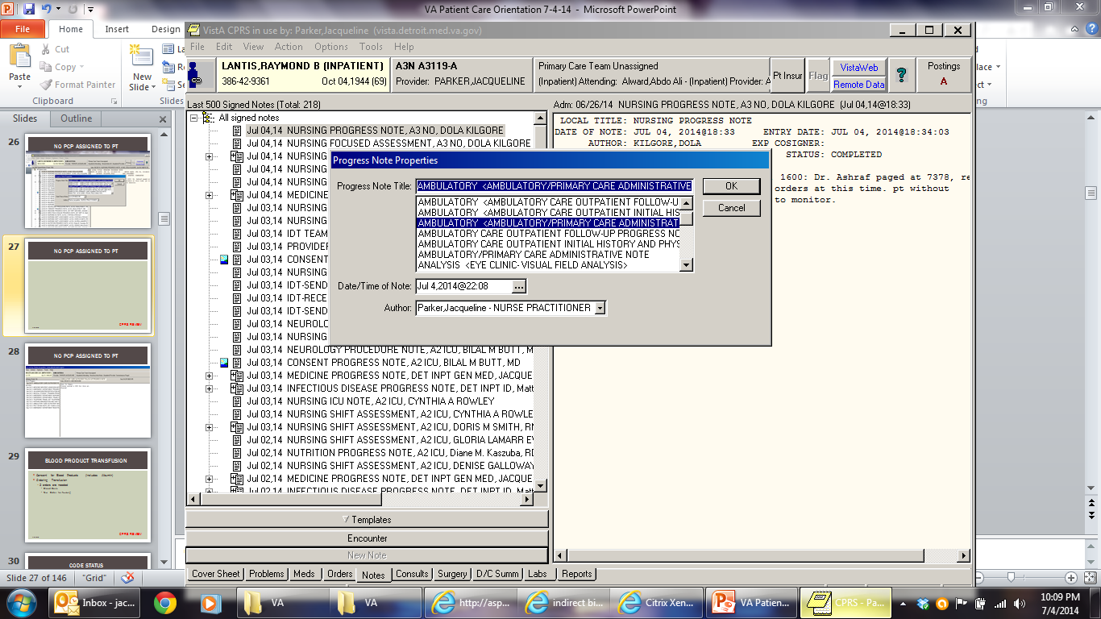
No PCP assigned to Pt
CPRS REVIEW

Slide 18
Blood product transfusion
Consent for Blood Products
Ordering Transfusion
2 orders are needed
Blood Bank
Text Order for Nursing
CPRS REVIEW

Slide 19
Code status
DNR/ DNI
Text Order
DNR Progress Note
Never check futile treatment in the template
Only document in patient or surrigate discussion
Only attending can determine futile treatment
Rescission of DNR / DNI
Text order
DNR Rescinded Progress Note
CPRS REVIEW

Slide 20
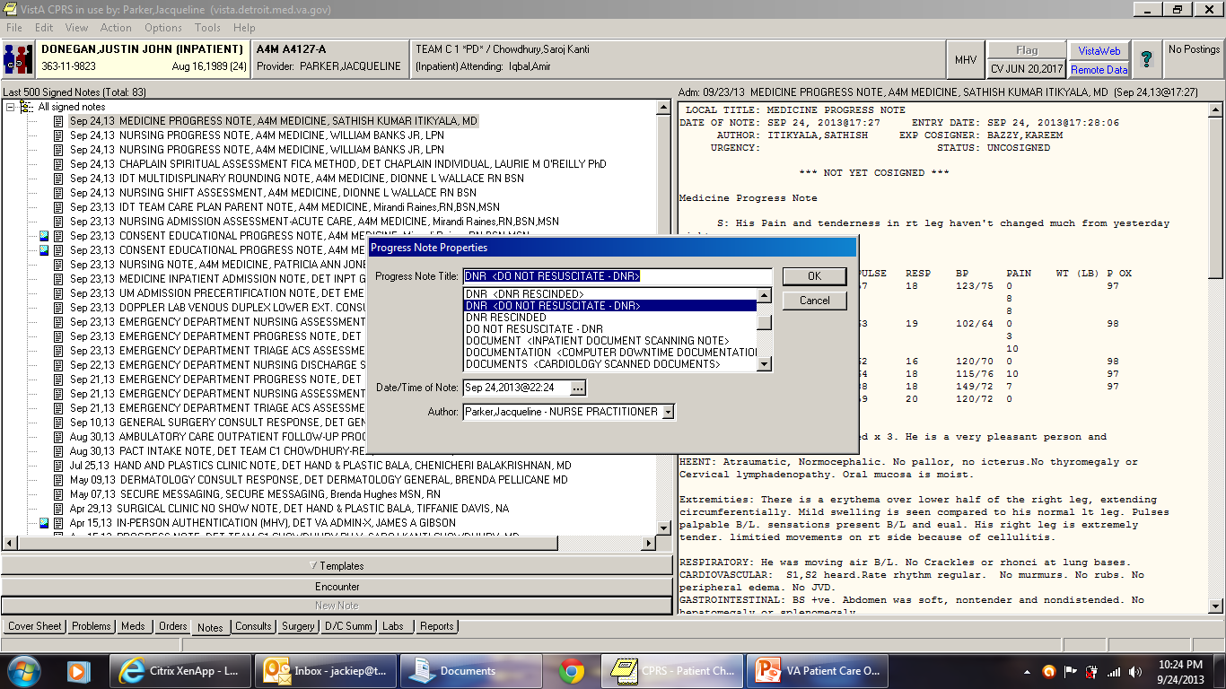
Code status
CPRS REVIEW

Slide 21
CPRS
Notes
Regroup notes
Default is ordered to visit date
Can regroup using “Custom View” according to:
Title
Location
Author
Vista Imaging
View EKGs
View scanned documents
Echos
PFTs
Doppler studies
Labs
Worksheet – to search specific lab results
Medication
Right-click Med > Administration History
CPRS REVIEW

Slide 22
Deleting a CPRS Note
Highlight note to be deleted
TOOLS > FEEDBACK > “head” icon
Type instructions to delete note saved in error
COPY/ PASTE demographic information about the note (Pt name, date, time of note, Note title, Note Author).
SEND FEEDBACK
This creates an EMAIL in VISTA to Clinical Informatics to have note deleted
Attach an addendum to note asking readers to disregard note
If needs to be deleted immediately; call Debra Friend (during working hours weekdays; 64559
CPRS REVIEW

Slide 23
Discharge note
Serves as Patient Discharge Instructions
Make instructions easy for pt to read and understand
No abbreviations
Write in information beyond what is offered in the template (i.e. dressing changes, tube care)
Please do medication reconcillation : cprs tools
Clinical applications before you do discharge note; cut the auto-populated medications and paste your medication reconcillations (also paste on d/c summary.
CPRS REVIEW

Slide 24
Discharge note
One D/C NOTE per hospitalization
What if?
Note is signed and there are changes: Addendum the note
Pt discharged on a different day from date on note: Addendum the note with correct discharge date
Diagnoses on the Discharge Note must mirror the diagnoses documented on the Discharge Summary

Slide 25
Discharge note
Nurses CANNOT discharge a pt without the Discharge Note
Print copy and give to Discharging Nurse
Add the Primary Care Provider as an additional signer (communicates disposition to the PCP)

Slide 26
Discharge planning: gec Referrals
Referral process used to request services such as
Home Care
Home IV Infusion
Home Based Primary Care
Subacute Rehab
Skilled Nursing
Nursing Home Placement
Hospice
Respite Care
Care coordinators should be a big help with these

Slide 27
Discharge planning: gec Referrals
Geriatric Extended Care Referral
Referral Process used to request services
CONSULT > NEW CONSULT > GEC INPT E-CONSULT (or)
CONSULT > NEW CONSULT > HBPC REFERRAL
Complete Template as appropriate
Some programs require some other action like placing a NON VA CARE CONSULT or Social Work Consult, the template will direct you accordingly
Screening committee meets each morning M-F to discuss referrals for approval
Look for Consult Response notes around mid-morning for response of the committee
CPRS REVIEW

Slide 28
Discharge planning: gec Referrals
HBPC (Home Based Primary Care) Referrals
Community Skilled Home Care
Medication Management,
Vital Sign Management,
Disease Management
Wound Care
Rehabilitation Services
Home Safety Evaluation
Physical Therapy
Occupational Therapy
Home Infusion Services
CPRS REVIEW

Slide 29
Discharge planning: gec Referrals

Slide 30
Discharge planning: gec Referrals
GEC Inpatient e-Consult Referral Programs
Inpatient Respite
Inpatient Hospice
Long Term Continuing Care
Acute Rehab
Short-Stayed Skilled
IV Antibiotics
Complex Wound Care
Radiation Treatment
Slow Rehab
Other
CPRS REVIEW

Slide 31
HOME TELEHEALTH
Consider Telehealth for following diagnoses:
CHF
HTN
DM
COPD
Palliative Care
Anticoagulation
Dementia
SCI
Obesity
FU barriers: remote areas; transportation, immobility, compliance
Consult > New Consult > Care Coordination Home Telehealth Screening

Slide 32
NON-VA Care consults
Process used to obtain services not provided by the VA
Old Term: Fee-Based Consult
GEC Response may ask you to place Non-VA Care consult to obtain needed services for pt who is not service-connected or without insurance
Examples:
Non-VA Care for Home Care
Non-VA Care for PET scan
Non-VA Care for Non VA Facility Transfer
Non-VA Care for Gastroenterology (pt needs Esophageal Manometry)
Non-VA Care Mammography
CPRS REVIEW

Slide 33
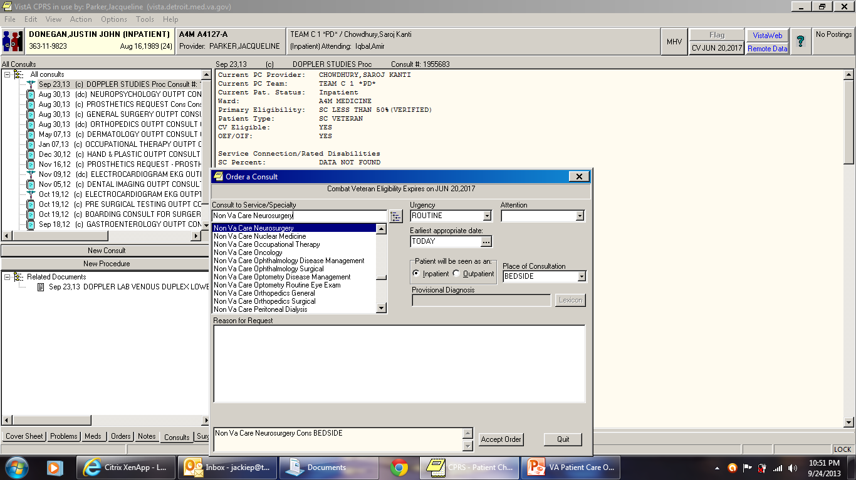
NON-VA Care consults
CPRS REVIEW

Slide 34
NON-VA Care consults
Provider completes Non-VA Care Consult in CPRS
NVCC staff review referral
Approval or denial is documented in form of “add comment” to the referral in CPRS
Non VA Care Coordination activities begin for approved referrals
Coordinating and facilitating the service
Pre/post-procedure preparation (i.e. lab work)
Confirmation that services were completed

Slide 35
Consents/Imed consents
Consents are done electronically
Need bedside computer
Signature pad
Consent software accessed via CPRS
Types
Procedure
Blood Transfusion
Consent for transfer to outside facility
Telephonic Consent (needs to be witnessed)
Hardware / Software problem resolution
Option to save is not highlighted → Print document
Bedside computers not working → Paper consent
Have Unit secretary scan paper consent into CPRS
Alert Nursing that a paper consent was obtained
CPRS REVIEW

Slide 36
Phone Consents
All consents (but one) have option to make consent a phone consent; please click box for this; and template will guide you with appropriate witnesses;
The administrative consent for ambulance transfer does not have an option for phone consent; This consent needs to be done if patient is being transferred to other hospital; nursing home; or by ambulance anywhere; We are trying to get this fixed; but meantime; easy fix
Choose option; patient unable to sign;
In the signature box for patient and surrogate write “Phone Consent” you sign as normal; and have witness sign;
Type name and relation of surrogate in one witness box

Slide 37
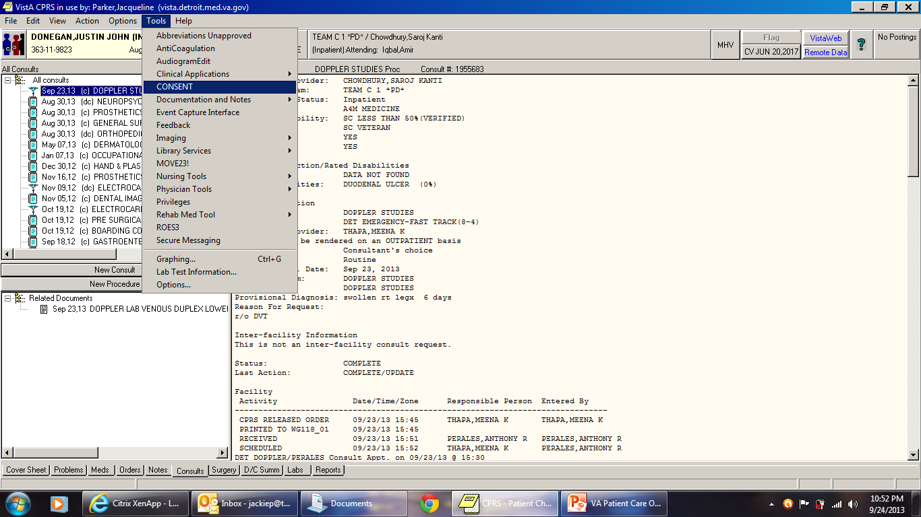
Consents/Imed consents
CPRS REVIEW

Slide 38
Diet ordering/ Nutrition /Dietetics
Regular or special diets
Tube Feeding
Supplements
TPN/ PPN
Dysphagia Diets
Fluid Restrictions

Slide 39
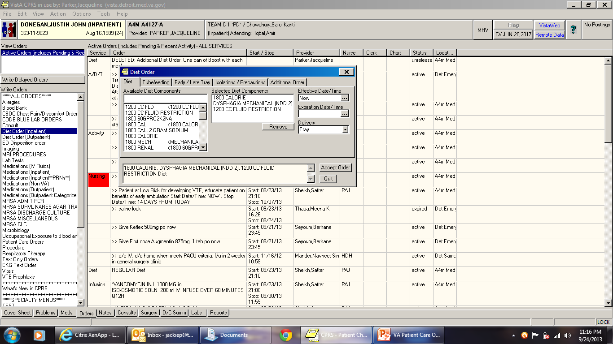
Diet ordering/ Nutrition /Dietetics

Slide 40
Pharmacy services
Pharmacy Dosing Consult
Dysphagia Consult
Anticoagulation Clinic (outpatient)
Nonformulary Requests
CPRS REVIEW

Slide 41
Pharmacy special Medication requests
Prior to ordering following medications, a Pharmacy Special Medication Request NOTE must be completed
After signing note, box to order medication pops up allowing you to prescribe the special medication
Amiodarone
Clonidine Patch
Clopidogrel
Colchicine
Darbepoetin
Erythropoietin
Fentanyl Patch
Fluoroquinolones
Atypical Antipsychotics

Slide 42
Pharmacy special Medication requests

Slide 43
Pharmacy special Medication requests

Slide 44
Physician order sets
Needle Stick Injury
TPN/ PPN
CIWA Protocol
Pneumonia
VTE Proph
Paracentesis
Thoracentesis
Lumbar Puncture
Aspart Sliding Scale
Discharge Menu
CPRS REVIEW

Slide 45
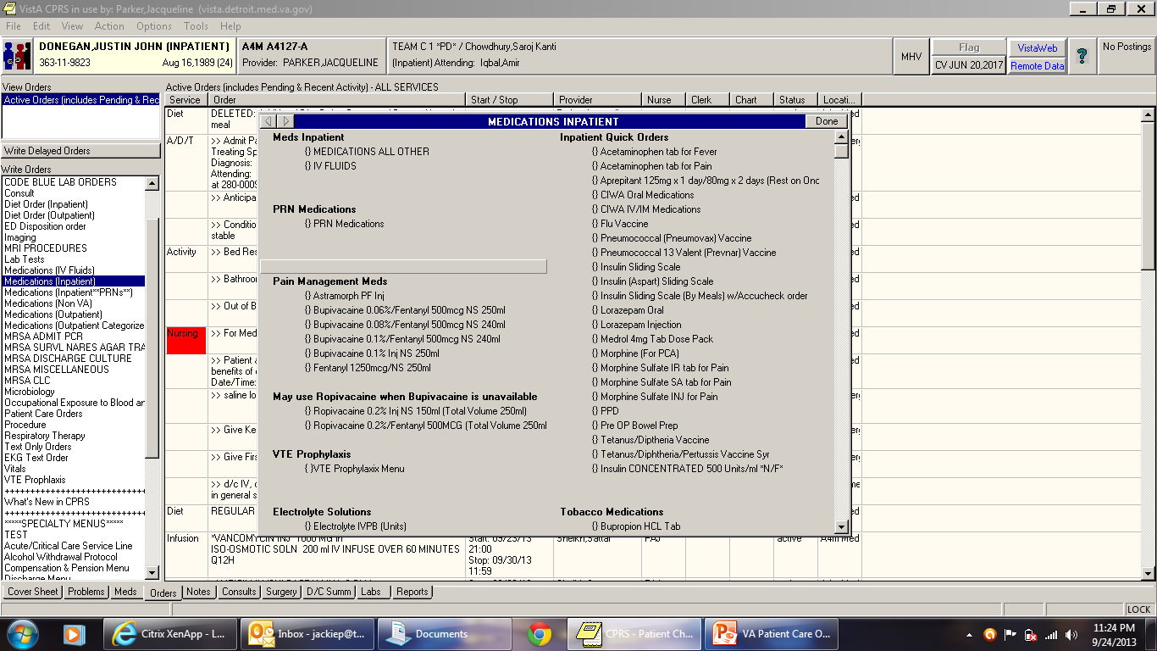
Physician order sets
CPRS REVIEW

Slide 46
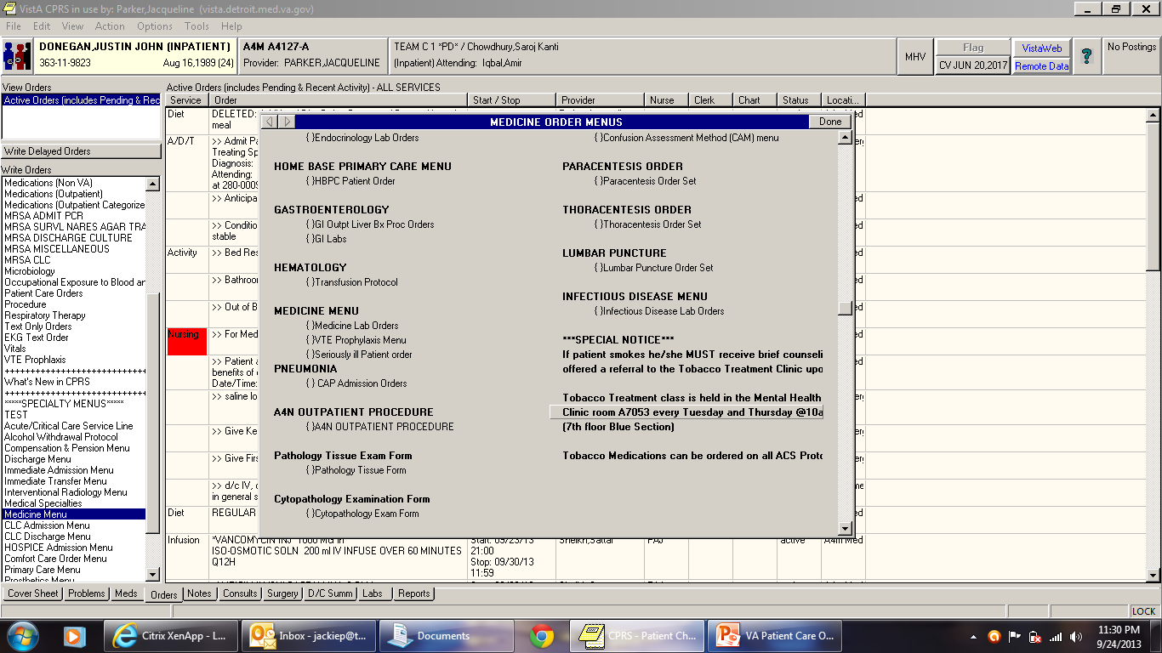
Physician order sets
CPRS REVIEW

Slide 47
Post-op orders / or patients
Medication and Text orders MAY AUTO-DC while pt is in OR: this does not always happen now and occasionally the surgery service will write your orders; but check after surgery!
AUTO-DC’ed orders can be viewed and selected to be reordered as active orders post-operatively
CPRS REVIEW

Slide 48
Restraints – Medical surgical
NEW Note: “Restraint or Seclusion Orders”
Complete the template
Completion of the template generates a window for text orders for type of restraints needed
Orders are time-limited to 24 hrs
Conduct in-person re-evaluation at least once each calendar day
Orders are issued no less often than once each calendar day
CPRS REVIEW

Slide 49
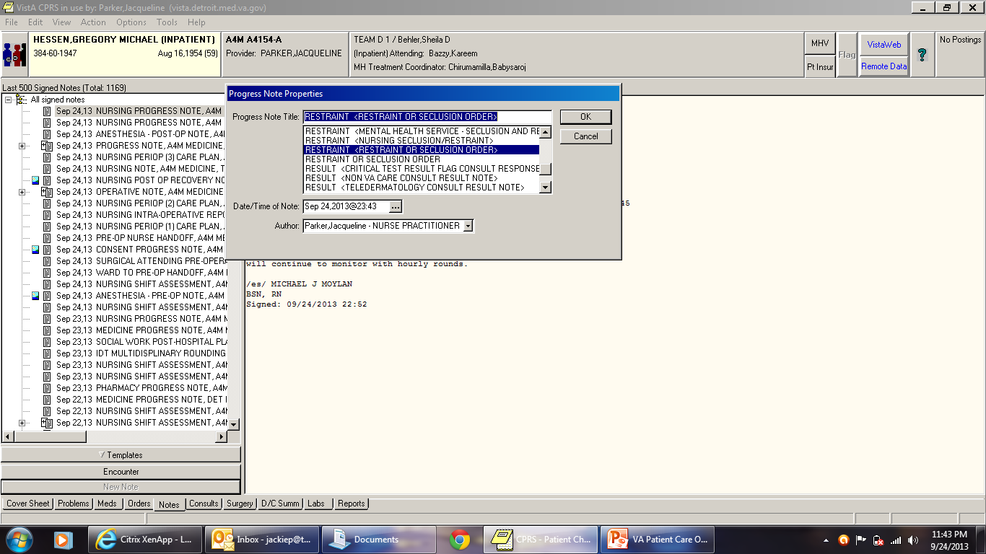
Restraints – Medical surgical
CPRS REVIEW

Slide 50
Records from other va centers vista web
Vista-Web/ Remote Data
Connects you to view the patient record at remote VA sites selected
Ann Arbor
Saginaw
Battle Creek
Other states
CPRS REVIEW

Slide 51
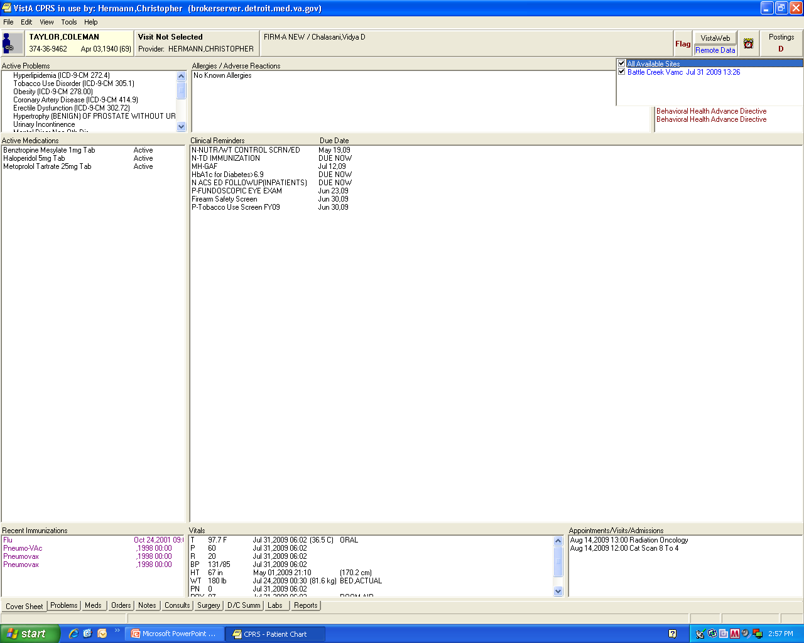
xxxxx

Slide 52
Tests or procedure ordering
Many tests are not intuitive when ordering in CPRS
IP Resource Guide gives ordering guidelines on common tests ordered

Slide 53
Veterans Unique Health risks
Environmental Exposures
Operation Enduring Freedom (OEF)
Operation Iraqi Freedom (OIF)
Operation New Dawn (OND)
Gulf War
Vietnam
Cold War
Korea
WWII

Slide 54
Veterans Unique Health risks
General Questions
“Can you tell me more about that?”
Compensation & Benefits
Sexual Harassment, Assault & Trauma
Exposure Concerns
Hepatitis C Virus (HCV) Infection
Living Situation
Stress Reactions/ Adjustment Problems

Slide 55
resources
Nurse Practitioners
Megan Irwin NP
Michelle Wagner-Smith
Levone McCullough
Amanda Less
Attending Physicians
Processes Guide – Paper and PDF version
Phone List
On Call Schedules (Access via VA Intranet/ Home page)
Medical Service Subspecialty list
Surgical on call list; available each day in recovery room

Slide 56
Inpatient Social Work
Karen Brandt 61135-63460
April Jackson 61135-65816
Rita Olugbile 61135-61332
Elizabeth Lucarelli 61135-61461
Weekend Coverage: Weekend pager 61135-69667
IP Specialty areas
DIALYSIS: Janill Deu 61135-63286
SCI: Ann Brady 61135-63684
HIV - Onelia Zurbruegg 61135-63498
Darius – Secretary 64946

Slide 57
Paging system
VA System for VA Employees
Access number: 61135-XXXX
Input 6 digit VA Pager number XXXX
Other VA Pagers
Begin with 250 or 280
No access number needed – just dial pager #
DMC Pagers
Access number: 313-745-0203
4 digit numbers
Looking up pager numbers
VISTA (from desktop)
DUZ
Operator

Slide 58
Phone system
Operator: “0”
Resource for pager & phone numbers
CODE location
Outside line
9-1-XXX-XXXX
For 313 area code: 9-XXX-XXXX
Other VA Hospitals
Dial last 5 digit of phone number from our phones
i.e. Ann Arbor bed control: Dial – 55279
Detroit VA: 313-576-1000 Extension #: 6XXXX
In-house dialing: 6XXXX

Slide 59
Batteries
Drained batteries mean unanswered pages – delaying pt care
Obtain batteries for your pagers from
SWITCHBOARD OFFICE in BASEMENT
Room LL 216 / Red zone (across from IRM)
Available after hours and during regular business hours

Slide 60
UNIT names & Locations
B2N – Psychiatry Unit (locked) 2nd floor Red
C4 – Stepdown / Telemetry 4th floor Yellow
A3Medicine – 3rd floor Blue
A5Surgery - 5th floor Blue
ICU 2nd floor Blue
5S – Short Stay/ Skilled Nursing / Rehab 5th floor Blue
5N – Community Living Center (CLC) – Nursing Home
A6N/ A6S – Community Living Center (CLC)
Telemetry beds – On A3N & area outside of C4

Slide 61
Emergency codes
BLUE – Medical Emergency
All outpatient emergencies will be called Code Blues
GREY – Rapid Response
GREEN – Disruptive pt without a weapon
SILVER – Disruptive pt with a weapon
WHITE – Stroke
ADAM – Missing Child
ORANGE - Suicide

Slide 62
Code white (stroke)
Means there is a victim of acute stroke who may be having an ischemic stroke and may be a candidate for t-PA
CODE WHITE TEAM
Neurology resident and/or Neurologist
Stroke Nurse (an ED Nurse with stroke training)
CT tech (gets CT scanner ready and alerts Radiologist on call)
Code Pharmacist (brings t-PA to all locations other than ED)
After hours, Stroke nurse will page the stroke attending who always has the stroke pager (250-0267). May take 30-45 min for arrival. Stroke nurse will pass phone to team physician
While awaiting Neurologist, provider and Stroke Nurse will initiate workup (Labs and CT)
Residents can feel free to call stroke attending (250-0267) for questions

Slide 63
What number d0 you call?
Medical Emergency 6333
Code blue, Code Gray, Code white
Code Green and Code Silver
Fire 63555: Code Red
a locate the fire pull alarms
Police 63375
These extension numbers located on each telephone handset in the medical center

Slide 64
Code Grey
On call resident team responsible to run code grey
ICU fellow tries to come during the day ; attending at night and on weekend, but they are not required to come
If you need them have them paged stat; Va pager 69167
Place icu consult later
Senior resident to write resident code grey note
Ongoing resident training by ICU team; mandatory simulations each rotations

Slide 65
Important software
CLINICAL ACCESS
Software to access Telemetry Monitoring history and alarms
Look for DESKTOP ICON: “Clinical Access”
Your attending has the Logon and Password for your team
ESSENTRIS
Software to access STEPDOWN and ICU vital signs and I&Os
Look for DESKTOP ICON: “ESSENTRIS”
Logon access is same as your CPRS logon

Slide 66
Telemetry
View Telemetry history and alarms via CLINICAL ACCESS
Location:
Beds on A3N
Area outside of C4 (Stepdown)

Slide 67
Telemetry PROVIDER Responsibilities
Make determination:
When a pt needs continuous telemetry monitoring
When telemetry should be discontinued
Evaluate ongoing need for telemetry on a daily basis
Obtain 12-lead EKG initially for all pts and with any significant events/ rhythm changes
Initiate telemetry monitoring via written text orders
Review and sign:
24-hour Telemetry Daily Summary Report (created by MIT at 2300)
Any Arrhythmia/Urgent notification notes
Review telemetry strips from Clinical Access that have been uploaded into Vista Images for CPRS viewing

Slide 68
Telemetry specifics
Telemetry Technician or other ACLS certified staff will maintain surveillance of telemetry at all times
Guidelines for Utilization of telemetry will be posted in our work areas
SMOKING while on Telemetry
Inform pt of their restriction to the ward (not allowed to go outside to smoke)
Offer Nicotine replacement treatment
Pt’s refusing to adhere:
Consider discontinuation of telemetry vs discharge AMA
Document discussion and action in record
Default alarm parameters: HR 50-120 SPO2 < 92
Continuous SPO2 monitoring capability for CHF, COPD, Pneumonia or PE pts

Slide 69
Guidelines for telemetry patient travel
Nursing staff MUST notify the Provider if a telemetry patient leaves the unit for diagnostic test
Cardiac telemetry patients require continual cardiac monitoring and RN accompaniment when leaving the unit
Guidelines for determining if pt can be off telemetry to leave the unit for a procedure
Must have provider order
Appendix A of Telemetry policy
Will be posted in work area
There is a list a guidelines for travel;if pt is unstable; on a vasoactive drip, in respiratory distress; he should have a nurse travel with him

Slide 70
Incident REPORTING: Epir
Report any Incidents or Near- Misses
Most incidents are PROCESS ISSUES that can and should be improved
Organization cannot improve unless they know what their issues are!
PLEASE REPORT! Incident reporting does not take a lot of time.
VA Intranet > Scroll down to “Helpful Links > Click on “Electronic Patient Incident Reporting (ePIR) > Click on large blue ePIR Icon

Slide 71
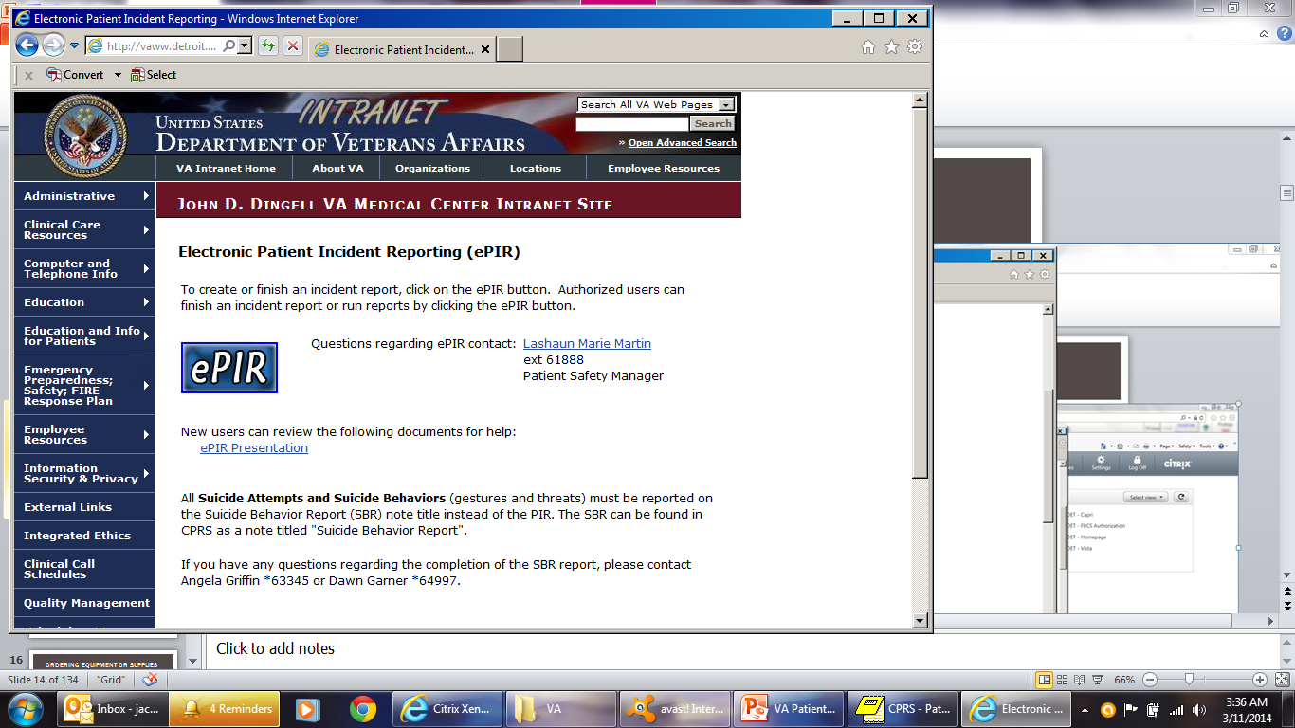
InCIDENT REPORTING: Epir

Slide 72
Ordering equipment or supplies
Outpatient Pharmacy → Medications (Outpatient)
Dressing supplies
Urinary Catheters
Ostomy supplies
Suction catheters
PleurX catheter supplies
Nutrition supplements (Place Dietician Consult for approval)
CPRS REVIEW

Slide 73
Ordering equipment or supplies
Prosthetics Consult
IV Poles
Suction Machines
Nebulizer
Blood Pressure Monitors
Hospital Beds
Hoyer Lifts
Bed Trapeze
Compression Stockings
Weight Scales
Diabetic shoes
Diabetic Socks
(In comments: ask for supplies to be delivered to floor)
CPRS REVIEW

Slide 74
Ordering equipment or supplies
Physical Therapy Consult
Walkers
Manual Wheelchairs
Canes
Rollators
Crutches
TENS unit
Occupational Therapy Consult
Shower bench
Raised toilet seats
Reachers
Sock Aids
Wrist splints
Grab Bars
Shoe Horns
CPRS REVIEW

Slide 75
Discharge summary
Complete within 24 hrs of discharge
Do not use abbreviations
Diagnoses must mirror the diagnoses listed on the Discharge Note
May embed medicine progress note in summary if done on same day; otherwise medicine progress note must be done on day of discharge
Ensure daily encounter is done on discharge note or empty med progress note specify see discharge summary for full note.

Slide 76
Discharge summary
VERA Diagnoses:
VETERANS EQUITABLE RESOURSE ALLOCATION
Every Veteran who is treated at a VA facility falls into a different VERA category
Each category has an assigned dollar amount and this is remitted to the facility every year
Certain diagnoses will result in categories with higher annual dollar amounts for our VA facility
ESRD
Hepatitis C
SCI
VERA diagnoses are added to the Discharge Note template to prompt providers to enter these if they apply (not to supplant your Discharge Diagnosis but to supplement the primary diagnosis if they apply)

Slide 77
Disposition of patients
Discharge to Home
48-Hour Observation
Discharge to Community Nursing Home
Discharge to VA Community Living Center (CLC)
Hospice / Nursing Home / Subacute Rehab / Skilled Nursing
Return to VA Detroit CLC
Interfacility Transfer to NON-VA Facility
Interfacility Transfer to another VA Facility
Discharge AMA
Death
Transfer to B2 (Psychiatry)
Transfer to another floor

Slide 78
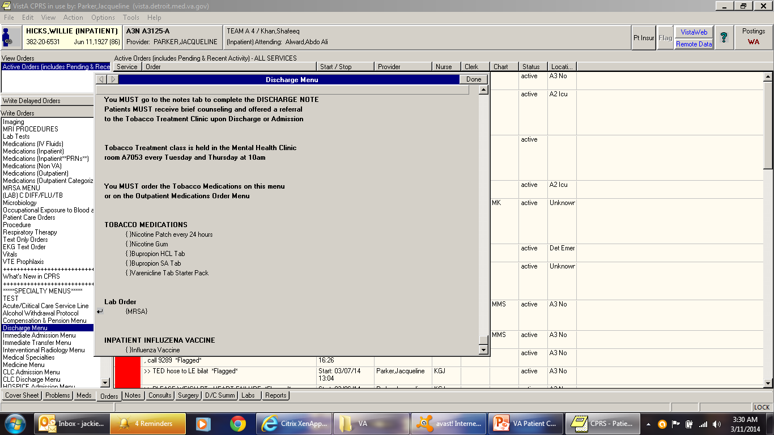
Disposition of patients

Slide 79
Discharge to home
Medication Reconciliation
FU appts
Discharge Note
MRSA swab and vaccinations (use Discharge Menu)
Discharge Order (Use Discharge Menu)
Discharge Summary

Slide 80
48-Hour Observation
Medication Reconciliation
FU appts
Discharge Note
MRSA swab and vaccinations (use Discharge Menu)
Discharge Order (Use Discharge Menu)
Does not need Discharge Summary
NOTE: If pt requires hospitalization longer than 48 hrs:
Pt must be discharged from Observation and readmitted to inpatient status

Slide 81
Converting Observation pt to full admission
Requirements:
DISCHARGE NOTE
Brief note indicating the disposition of the patient and the reason for conversion to full admission
TO AVOID NEEDING TO CLICK THROUGH WHOLE TEMPLATE:
After opening up Discharge Note template, when asked if note is Deceased vs Live Pt, CLICK CANCEL and then YES to create a BLANK NOTE
On BLANK NOTE: place a brief note with required documentation
MEDICINE INPATIENT ADMISSION NOTE
Replaces Progress note for that day
TO AVOID NEEDING TO CLICK THROUGH WHOLE TEMPLATE:
After opening up Discharge Note template, when asked if note is Deceased vs Live Pt, CLICK CANCEL and then YES to create a BLANK NOTE
On BLANK NOTE: place a brief note with required documentation
New Delayed Admission Orders
Contact Precertification Nurse
NOTE: If pt requires hospitalization longer than 48 hrs:
Pt must be discharged from Observation and readmitted to inpatient status

Slide 82
DC to Nursing Home (non-VA)
Arrange for Ambulance Travel
Consent for ambulance travel (see phone consents)
Medication Reconciliation
FU appts
Discharge Note
MRSA swab and vaccinations (use Discharge Menu)
Discharge Order (Use Discharge Menu)
Discharge Summary

Slide 83
DC to VA Detroit CLC (Nsg Home)
Will be notified by CLC Providers when bed is available
Medication Reconciliation
FU appts
Discharge Note
MRSA swab and vaccinations (use Discharge Menu)
Discharge Order (Use Discharge Menu)
Discharge Summary
Delayed Admission Orders: Admit Community Living Center – will be completed by CLC providers

Slide 84
Interfacility transfer to Non-Va facility
Contact Chief of Staff (Dr Gruber) for permission
Accepting physician handoff
Bed availability – Contact Admitting dept of receiving hosp
Non-VA Care Consult to NON-VA Facility
Arrange for Ambulance Transportation
**CONSENT for INTERFACILITY TRANSFER
**INTERFACILITY TRANSFER NOTE
Medication Reconciliation
FU appts
Discharge Note
MRSA swab and vaccinations (use Discharge Menu)
Discharge Order (Use Discharge Menu)
Discharge Summary

Slide 85
Discharge AMA
Counsel patient on risks
Have pt sign AMA paperwork
AMA Note
Medication Reconciliation
FU appts
Discharge Note
MRSA swab and vaccinations (use Discharge Menu)
Discharge Order (Use Discharge Menu > AMA)
Discharge Summary

Slide 86
Death
Pronounce pt
Notify Family
Autopsy request
Medical Examiner Case?
Progress note documenting above
FORMS: Pt Demise Checklist/Authorization for Autopsy
Gift for life
Discharge Note
Discharge Summary
Death Certificate signed within 24 hrs (attending)

Slide 87
Transfer to another floor
**For transfer to higher level of care: Call Precertification Nurse
**Call Bed Control for bed assignment/ availability
Consult MICU if ICU care needed
If transfer to another service, contact service provider for acceptance
**Provider providing care on receiving floor writes DELAYED TRANSFER ORDERS (Can only be done when bed available)
**Sending provider completes IDT SENDING PROVIDER NOTE
**If there is a provider change, the accepting provider completes IDT RECEIVING PROVIDER NOTE
Medication Reconciliation
MRSA swab (ordered with delayed transfer orders)
(** = must be completed for Nursing to transfer pt)

Slide 88
Transfer to B2/ Psychiatry
Contact Inpatient Psychiatry providers for acceptance and handoff
Call Bed Control for bed assignment/ availability
Precertification
IDT Sending Provider Note
Medication Reconciliation
FU appts
( No Discharge Note )
MRSA swab and vaccinations (use Discharge Menu)
Delayed Transfer Orders completed by Inpatient Psychiatry Providers

Slide 89
Conditions that must be transferred to outside facility
Major Trauma
Neurosurgery Emergencies
STEMI
Obstetric Emergencies
Gynecologic Emergencies (if GYN provider not available)
Symptomatic thoracic or abdominal aneurysms
Functioning Solid-Organ Transplant (kidney, liver, pancreas, heart, lung, small bowel or multivisceral) on maintenance immunosuppression requiring hospitalization

Slide 90
Expiring medications
Daily review the inpatient medications
Narcotics automatically expire after 72 hrs
Antibiotics expire after 7 days
IV Orders

Slide 91
Home o2 evaluation
Consult Respiratory therapy detail you want home O2 eval.”
Respiratory therapy consult: Not home O2 consult this is a recent change
Document why; if possible document hypoxia in equest.
Call home O2; desk: 63483 Tanya; 65900 or page Toney
Hilu 350-5146
Home O2 Prescriptions need to be signed by MD (RT will send Prescription via CPRS for electronic signature)
Pt/family need to call Home O2 “800” number to arrange for home delivery of oxygen at discharge (RT gives this number to pt/family)
Planning weekend discharges, have this done prior to weekend; but now can be delivered on Saturday

Slide 92
Medication reconciliation
Creating the most accurate list possible of all medications a patient is taking
Compares the patient’s medication orders to all of the medications that the patient has been taking (and should be taking).
Avoid medication errors such as omissions, duplications, dosing errors, or drug interactions
Compare against the list of the physician’s admission, transfer, and/or discharge orders
Done at every transition of care in which new medications are ordered or existing orders are rewritten
CPRS REVIEW

Slide 93
Medication reconciliation
Bring printout of VA Prescribed Medications to the bedside when interviewing pt
Make needed changes to Medication Orders based upon your Medication Reconciliation assessment
Document any NON-VA prescribed medications under “NON-VA MEDICATIONS”
Documentation
Admission: → within your H&P
MUST USE VA TEMPLATE! (contains Med Rec info)
or use separate Medication Reconciliation Note
Transfers: → Transfer Note med; rec on icu transfers; use Transfer Note template; has medrec embedded. ; other transfers should use med red note
Discharge: → within your Discharge Note: copy and paste new med rec tool
CPRS REVIEW

Slide 94
Mental health resources
Mental Health Clinic
Inpatient Mental Health (B2)
Mental Health Intensive Case Management
Partial Hospitalization Program
Chemical Dependency Program
Intake Exam
7th floor
M W F btw 8am and 10am
PTSD Clinic
Military Sexual Trauma (MST) Service
Services for Homeless Veterans

Slide 95
OUTpt Controlled substance Rx
Providers must have PIV card to prescribe controlled substances
For providers without a PIV card
Have your attending or NP sign your Rx or other resident

Slide 96
Wound /enterostomal nurse consults
For all identified pressure ulcers
Venous ulcers, Arterial ulcers, Foot ulcers, Wound VAC
To facilitate getting ostomy or wound supplies
All units have “Wound Champions” – RNs with special training to recommend dressings (called BUS team members)
Specialty mattresses
as of now there is no outpatient wound care; pt’s must follow-up with outpatient surgery;
They are actively recruiting to replace this positons.

Slide 97
When in doubt, just ask.

