Slide 1
Anxiety
AHMED YASSIN

Slide 2
Mr. O is a 45-year-old Hawaiian-born executive. His last use of cocaine or heroin was 5 years ago. He reports several episodes each week of tremor, diaphoresis, a feeling of fear, and palpitations. He has been greatly affected by these episodes, and reports less interest in leaving home; this has caused him to feel anxious about missing work. He was held up at gunpoint at the age of 30. Occasionally he thinks about the episode but does not feel like he is more vigilant than normal.
Which of the following is the most likely diagnosis?
a) PTSD
b) Depression
c) Generalized anxiety disorder
d) Panic disorder
e) Substance abuse

Slide 3
You are evaluating Ms. S, a 35-year-old woman with 6 months of restlessness, irritability and muscle tension. Among the following, which one is an additional symptom that is diagnostic of generalized anxiety disorder?
a) Lack of appetite
b) Sleep disturbance
c) Suicidal ideation
d) Anhedonia

Slide 4
Diagnostic criteria for anxiety include that the anxiety causes significant impairment in which of the following areas?
a) Family
b) Work
c) School
d) Emotional distress
e) All of the above

Slide 5
You start a patient on an SSRI for the treatment of anxiety. When should you assess the patient’s response to treatment?
a) Two weeks
b) Four to six weeks
c) Three months
d) Six months

Slide 6
For which one of the following patients diagnosed with anxiety, there are no contraindications to the use of a benzodiazepine?
a) A 57-year-old woman with COPD with frequent exacerbations
b) A 35-year-old man with seizure disorder, on two anticonvulsants
c) A 41-year-old man with remote history of substance abuse, successfully treated
d) An 80-year-old woman with frequent falls in the past month

Slide 7
You start a patient on pharmacotherapy for treatment of anxiety. The patient asks how long she will have to take the medicine. The appropriate duration of treatment is:
a) Anxiety treatment is continued indefinitely
b) Consider discontinuation in one to two months
c) Consider discontinuation in six months
d) Consider discontinuation in one year

Slide 8
GAD
The lifetime prevalence of GAD in American adults is 5%
Bad disease
Personal distress, missed work, and overuse of medical services
associated with a significant and independent risk of suicide attempt

Slide 9
Risk factors for generalized anxiety disorder include :
Female gender
Older age
Positive family history
Weak evidence : stress, a history of physical and emotional trauma, and smoking

Slide 10
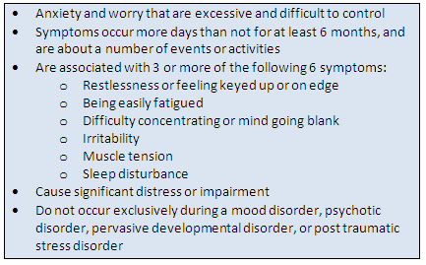
Diagnostic criteria for anxiety

Slide 11
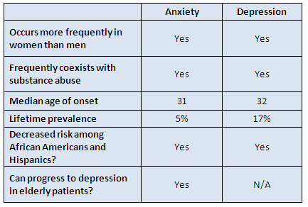
Anxiety and depression: similarities and differences

Slide 12
Controversies in diagnosis
Some authors have proposed reclassifying GAD as a mood disorder.
According to most recent criteria, a patient with diagnosed depression can only be diagnosed with anxiety once depression has undergone remission.
when managing a patient with depression and anxiety, we first treat the depression, as anxiety often improves with treatment of depression.

Slide 13
Screening and diagnosis
One tool used to screen or evaluate patients with a potential anxiety disorder is the Generalized Anxiety Disorder 7-question (GAD-7) scale.

Slide 14
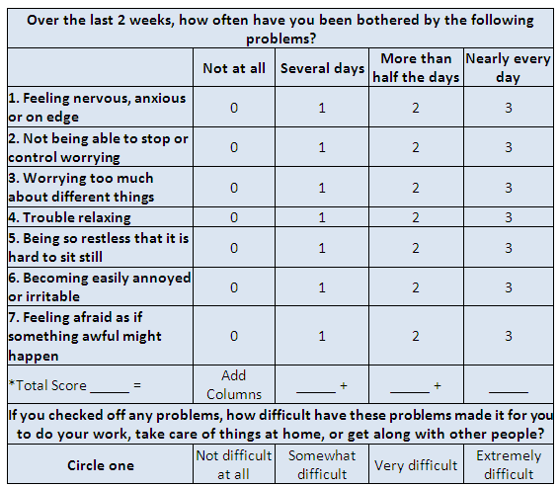
GAD-7
Score: 5-9 = mild anxiety; 10-14 = moderate anxiety; 15-21 = severe anxiety

Slide 15
GAD-2
GAD-2 Scale is a screening tools for all anxiety disorders, including GAD.
GAD-2 asks:
1. “Over the last 2 weeks, have you felt nervous, anxious, or on edge” and 2. “Over the last 2 weeks, have you felt not able to stop or control your worrying?’

Slide 16
A 58-year-old woman comes to you complaining of 2 weeks of daily irritability and daily worrying, with occasional trouble relaxing. She denies nervous or anxious feeling, problems stopping or controlling her worrying, restlessness, or feeling that something awful might happen. Your next step in evaluation is:
a) Empiric treatment for anxiety
b) Complete initial medical evaluation
c) Assess for depression
d) Both B and C

Slide 17
d) Both B and C
Always exclude depression and medical disease that might have similar presentation.

Slide 18
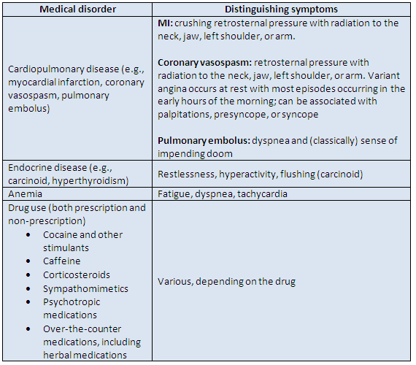
Differential diagnosis: Medical disorders

Slide 19
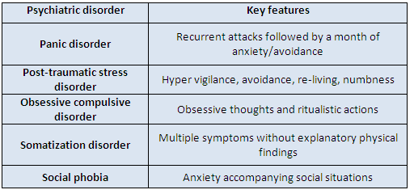
Different Diagnosis: psychiatric disorders

Slide 20
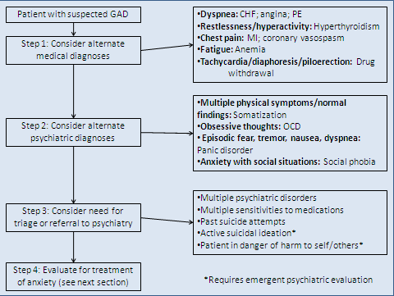
Algorithm for evaluation of patients with suspected GAD

Slide 21
An 86-year-old woman with a history of seizure disorder, COPD, and falls, comes to you for a return visit. At her first visit with you, you diagnosed an anxiety disorder. Her anxiety symptoms make it difficult for her to enjoy life. Which of the following is likely to be the safest combination of medications given her comorbidities?
a) SSRI and short-acting benzodiazepines for acute anxiety
b) SSRI and long-acting benzodiazepine for acute anxiety
c) SSRI as monotherapy
d) TCAs at low to moderate doses.

Slide 22
c) SSRI as monotherapy

Slide 23
Deciding between pharmacotherapy and non-pharmacological therapy
There are no generally accepted evidence-based guidelines for using cognitive behavioral therapy, or other non-pharmacologic modalities (e.g., meditation, other relaxation techniques, exercise) versus pharmacologic therapy
Two meta-analyses have compared pharmacotherapy with cognitive behavioral therapy (CBT) for treatment of GAD (25,26).In both meta-analyses, pharmacotherapy and counseling are equally effective in treatment of GAD.

Slide 24
In general, the patient’s severity of symptoms, psychiatric and other comorbidities, history of previous pharmacologic therapy, history of drug allergies and other adverse reactions, and readiness to comply with therapy should be taken into account whenever choosing treatment

Slide 25
Should I refer to psychiatry?
Reasons to refer to psychiatry for initial treatment of GAD include the following: 1. Comorbid depression refractory to treatment 2. Psychosis 3. Personality disorders which make treatment for GAD difficult or unfeasible 4. Sensitivity or adverse reaction to multiple medication classes 5. Active suicidal ideation

Slide 26
What is the severity of this patient’s anxiety?
Is depression present?
What has worked before for this patient?
Is there a significant risk of suicide?

Slide 27
Pharmacological Therapy
Antidepressants: SSRIs and SNRIs are commonly viewed as first-line medications for the treatment of GAD.
Remember: 2-4 week delay before symptomatic relief begins, side effects are common (including jitteriness, diarrhea, and sexual dysfunction), often occurring before therapeutic effects, making compliance a challenge.

Slide 28
The time until clinical effectiveness of SSRIs can pose a problem in patients with acute anxiety. For that reason, benzodiazepines (BZDs) are often used as short term control of anxiety until the effects of the antidepressant kick in.

Slide 29
Anxiolytics
Benzodiazepines (BZDs) are often considered as short-term treatment for anxiety given their relatively short time of onset (ranging from about ½ to 1 hour) and effective duration (from about 5 to 15 hours)

Slide 30
Low potency, like diazepam and lorazepam (sedation, cognitive impairment, and falls, especially in the elderly)
High potency like clonazepam and alprazolam (longer half life and stable effect and easy to taper when start with SSRIs)

Slide 31
Other Agents
Pregabalin: Also effective in panic and social anxiety disorders.
Buspirone: downsides include slow onset, significant adverse effects (including dizziness, drowsiness and nausea) and lack of effectiveness in treating comorbid psychiatric conditions.

Slide 32
Duration of therapy
Lack of data for treatment duration
In the treatment of the Anxiety, a trial off therapy can be considered after six months of successful control

Slide 33
Treatment-resistant anxiety
Unfortunately, there is a lack of evidence on effective treatments in patients with refractory anxiety.
Clearly this represents a research gap and a barrier to clinical care in this population.

Slide 34
To take home
Finally, while primary care providers are often the first to diagnose and treat anxiety
Anxiety cause personal distress, missed work, and overuse of medical services and associated with a significant and independent risk of suicide attempt
One tool used to screen or evaluate patients with a potential anxiety disorder is the Generalized Anxiety Disorder 7-question (GAD-7) scale.
when managing a patient with depression and anxiety, we first treat the depression, as anxiety often improves with treatment of depression.
There are no generally accepted evidence-based guidelines for using cognitive behavioral therapy, or other non-pharmacologic modalities (e.g., meditation, other relaxation techniques, exercise) versus pharmacologic therapy
In the treatment of the Anxiety, a trial off therapy can be considered after six months of successful control

Slide 35
Mr. O is a 45-year-old Hawaiian-born executive. His last use of cocaine or heroin was 5 years ago. He reports several episodes each week of tremor, diaphoresis, a feeling of fear, and palpitations. He has been greatly affected by these episodes, and reports less interest in leaving home; this has caused him to feel anxious about missing work. He was held up at gunpoint at the age of 30. Occasionally he thinks about the episode but does not feel like he is more vigilant than normal.
Which of the following is the most likely diagnosis?
a) PTSD
b) Depression
c) Generalized anxiety disorder
d) Panic disorder
e) Substance abuse

Slide 36
d) Panic disorder

Slide 37
You are evaluating Ms. S, a 35-year-old woman with 6 months of restlessness, irritability and muscle tension. Among the following, which one is an additional symptom that is diagnostic of generalized anxiety disorder?
a) Lack of appetite
b) Sleep disturbance
c) Suicidal ideation
d) Anhedonia

Slide 38
b) Sleep disturbance

Slide 39
Diagnostic criteria for anxiety include that the anxiety causes significant impairment in which of the following areas?
a) Family
b) Work
c) School
d) Emotional distress
e) All of the above

Slide 40
e) All of the above

Slide 41
You start a patient on an SSRI for the treatment of anxiety. When should you assess the patient’s response to treatment?
a) Two weeks
b) Four to six weeks
c) Three months
d) Six months

Slide 42
b) Four to six weeks
Contact with the patient should be initiated a week after starting treatment to guard against suicidal ideation, and in a month to ascertain compliance or the presence of significant adverse effects. Symptomatic relief should be expected, if present, in 4-6 weeks.

Slide 43
For which one of the following patients diagnosed with anxiety there are no contraindications to the use of a benzodiazepine?
a) A 57-year-old woman with COPD with frequent exacerbations
b) A 35-year-old man with seizure disorder, on two anticonvulsants
c) A 41-year-old man with remote history of substance abuse, successfully treated
d) An 80-year-old woman with frequent falls in the past month

Slide 44
c) A 41-year-old man with remote history of substance abuse, successfully treated
Benzodiazepines are generally appropriate for the treatment of acute episodes of anxiety. Medical contraindications to their use include convulsive disorders, active respiratory disease, hepatic or renal impairment, or current substance abuse. They should be prescribed with caution in patients with dementia or active depression.

Slide 45
You start a patient on pharmacotherapy for treatment of anxiety. The patient asks how long she will have to take the medicine. The appropriate duration of treatment is:
a) Anxiety treatment is continued indefinitely
b) Consider discontinuation in one to two months
c) Consider discontinuation in six months
d) Consider discontinuation in one year

Slide 46
c) Consider discontinuation in six months
in patients with Anxiety disorder which is well controlled on medications, there is a possibility that they can be titrated off starting at 6 months. However, the possibility of relapse should always be discussed by doctor and patient.

Slide 47
Mr. W. is a 45-year-old politician without significant medical history who has been recently implicated in a scandal. This has caused exacerbation of his anxiety disorder, which was previously well-controlled through regular counseling. He continues to see his therapist but wishes to discuss medications for the treatment of his anxiety. He says that he has some benzodiazepines at home and would like to use them for treatment. Which of the responses below would be most appropriate?
a) Benzodiazepines are highly addictive and thus they are not appropriate for the treatment of anxiety.
b) BZDs are not affective for the treatment of anxiety; SSRIs are the medication of choice.
c) BZDs are generally appropriate for the treatment of acute episodes of anxiety providing no medical contraindications exist.
d) His therapist should be able to prescribe him psychoactive medications due to recent legislation.

Slide 48
c) BZDs are generally appropriate for the treatment of acute episodes of anxiety providing no medical contraindications exist.
Benzodiazepines are generally appropriate for the treatment of acute episodes of anxiety.

Slide 49
You see Mr. W. again for consideration of pharmacological agents for the chronic treatment of his anxiety. On further discussion it turns out that he has a significant past psychiatric history, including treatment for depression, and that he has had experience with a number of medications which he would prefer not to try again. In particular, he would like to avoid SSRIs. Which of the following options can you offer to him?
a) Venlafaxine
b) Bupropion
c) Pregabalin
d) Buspirone
e) All of the above

Slide 50
e) All of the above
Medications for the treatment of generalized anxiety disorder include SSRIs, SNRIs (including venlafaxine), and other medications with various mechanisms of action (including buspirone, bupropion, and pregabalin).

Slide 51
You and Mr. W. choose a medication for treatment of his chronic anxiety. Before starting the medication, he asks you how long he should expect until he finds relief from his symptoms. He also wants to know when he needs to come back to see you. What do you tell him?
a) Contact you in a week, return visit in a month, relief in 4-6 weeks
b) Relief in 1 month, return visit then
c) Contact you in a month, relief in 2-3 months
d) Relief in 2-4 weeks, return visit around then

Slide 52
a) Contact you in a week, return visit in a month, relief in 4-6 weeks
Contact with the patient should be initiated a week after starting treatment to guard against suicidal ideation, and in a month to ascertain compliance or the presence of significant adverse effects. Symptomatic relief should be expected, if present, in 4-6 weeks.

Slide 53
Thank You

