Slide 1
Human Immunodeficiency Virus Part II
Catherine Czesnowski MD.
PYG 1 IM

Slide 2
Pathogenesis and Natural History of Infection
Found to be the etiologic agent of AIDS in 1983
HIV is a lentivirus subfamily of human retroviruses
Virus codes for the enzyme reverse transcriptase:
allows transcription of viral RNA into proviral DNA and subsequent integration into the host’s cellular genome, leading to a persistent, latent infection
Retroviruses are associated with diseases of long incubation period, involvement with the hematopoietic and central nervous systems, and immune suppression.
HIV preferentially infects human T lymphocytes of the helper/inducer subset (AKA CD4 cells).

Slide 3
Pathogenesis and Natural History of Infection
HIV infection impairs cell-mediated immunity, making the patient susceptible to a number of opportunistic infections.
Uninfected people typically have 800-1200 CD4 cells/mm3, whereas HIV-infected patients with opportunistic infections usually have fewer than 200 CD4 cells/mm3 .
Thus, monitoring the CD4 cell count is useful for predicting the degree of suppression of a patient’s cell-mediated immunity, guiding the differential diagnosis of new symptoms, and deciding when to initiate prophylaxis for opportunistic infection.

Slide 4
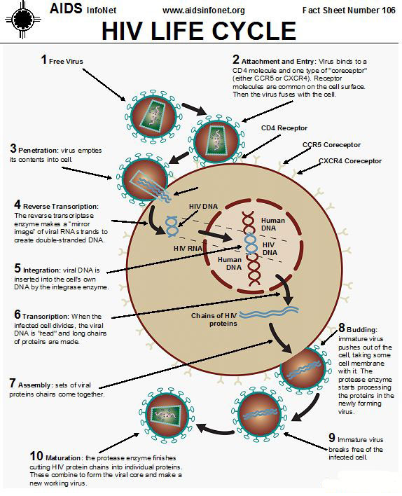
Pathogenesis and Natural History of Infection
Binding and fusion. HIV binds to CD4 receptors and co-receptors, then fuses with and releases its genetic material into the host cell.
Reverse transcription. Reverse transcriptase converts the single-stranded RNA of the virus to a double-stranded HIV DNA.
Integration. The HIV DNA enters the host cell's nucleus and an HIV enzyme, integrase, integrates the HIV DNA into the host cell DNA. This 'provirus' can remain dormant for years before creating new copies.
Transcription. When the host cell is activated, the host's RNA polymerase creates copies of the HIV genomic material, as well as mRNA, which is used to make HIV proteins.
Assembly. Protease, an HIV enzyme, cuts the chains of HIV proteins and these smaller proteins join with HIV RNA to create new virus particles.
Budding. The newly-assembled virus 'buds' from the host cell, taking part of the host cell's outer membrane in the process.

Slide 5
Treatment of HIV
The mean length of time from seroconversion to symptomatic AIDS in untreated patients is 10 years; however, this varies considerably from person to person and probably reflects variations in individual immune systems and the virulence of different strains of the virus.
Expanded use of antiretroviral therapy, prophylaxis against opportunistic infections, and treatment of AIDS associated conditions has resulted in delayed progression and longer life expectancies for HIV infected people.

Slide 6
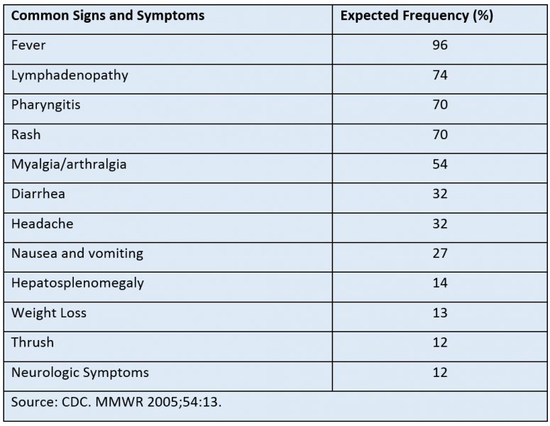
Acute Retroviral Syndrome
Primary HIV infection (“acute retroviral syndrome”) is usually symptomatic in the form of a mild to severe flu-like illness.
The most common signs and symptoms are fever, lymphadenopathy, pharyngitis and rash. The syndrome is nonspecific and cannot be differentiated from other acute viral illnesses on the basis of signs or symptoms alone. Patients often do not seek medical attention and even when they do, the infection is generally not recognized.
There is a wide range of severe but less common presentations of primary HIV infection that have been reported; these include: opportunistic infections, acute renal failure, rhabdomyolysis and vasculitis.

Slide 7
Acute Retroviral Syndrome
Because of the nonspecific nature of the illness, clinicians need to maintain a high index of suspicion to identify patients with primary HIV infection.
The diagnosis can be made by measuring HIV RNA level (viral load); an elevated viral load (usually over 100,000 copies/mL) in the presence of a negative HIV ELISA, establishes the diagnosis.
Viral load is 100% sensitive and 97% specific; however, specificity for viral load approaches 100% if a cutoff of 10,000 copies/mL is used (i.e. false-positive viral load titers are usually <10,000 copies/ml).
Recognizing primary HIV infection is important because it can help prevent further transmission and help ensure timely treatment for the infected individual. Antiretroviral treatment during acute infection may also be beneficial and is recommended under current guidelines.
The incubation period (time from exposure to onset of illness) for the acute syndrome is estimated to be between 4 to 11 days. During the period of initial infection, virus levels are high, HIV is widely disseminated, and there is a transient decrease in CD4 cells. There is an immune response to HIV between 1 week and 3 months after infection, and antibodies are usually detectable 6 to 12 weeks after the initial exposure. The early immune response is associated with a dramatic decrease in viremia, but viral replication is never completely curtailed, particularly in lymphoid tissue. The typical course of HIV infection (without antiretroviral treatment) is shown in the following figure.

Slide 8
Question
A 20 year-old female presents with an acute febrile illness with cough, sore throat sinus congestion and runny nose. She is a commercial sex worker and has had unprotected sexual intercourse with a number of partners. She had a serum HIV test three months ago, which was negative. A rapid HIV antibody test is negative, and HIV viral load is 1,100. Which one of the following is the most likely explanation for her test results?
a) She has acute HIV infection.
b) She has chronic HIV infection and a false negative rapid HIV antibody test.
c) She is not HIV-infected and her viral load is a false positive test.
d) She has been exposed to HIV and is clearing the infection.

Slide 9
Evaluation of HIV patients
Patients infected with HIV need psychosocial support, medical assessment, and preventive care. The diagnosis of HIV carries with it huge psychological burdens. In addition to the psychosocial issues, the medical assessment should include:
Detailed sex history including other sexually transmitted infections, current sexual practices, and current sexual partners and whether they have been notified of their possible exposure
History of drug and alcohol use, including screening for current substance use
Psychiatric history
Related infectious diseases, including: Tuberculosis, (most recent PPD and PPD history) Hepatitis C, and Hepatitis B infection or immunization
Immunizations; including: Influenza, Pneumococcus, Hepatitis B, Meningococcus
Relevant cancer screening (i.e. cervical cancer screening in females, including history of abnormal Pap smears)

Slide 10
Evaluation of HIV patients
The physical exam should include an oral exam looking for thrush, exam of lymphatic system for enlarged nodes, genital and anal exam for condyloma and other lesions, a pelvic exam for females, full skin exam for Kaposi’s sarcoma and other dermatologic conditions associated with HIV.
The baseline laboratory evaluation should establish a database that will be useful for identifying already present abnormalities and for comparison when abnormalities are identified at a later time in the care of the patient.
Should include a complete blood count, hepatitis B surface antigen and antibody, syphilis serology, Toxoplasma antibody, HIV viral load, and CD4 lymphocyte count. I
Consider Hepatitis C antibiody in injection drug users and their partners
Conisder PPD if the patient has a history of a positive PPD skin test or TB.
A chest xray should be performed in all patients who have a positive PPD (in HIV-infected individuals, a positive result is 5 mm or more induration) or have respiratory symptoms.
Genotypic resistance testing should also be done on all newly diagnosed HIV-infected patients, to detect transmission of resistant virus.

Slide 11
Preventative Care in HIV patients Vaccinations
Hepatitis B vaccine should be given in hepatitis B surface antigen and antibody-negative patients because of the increased risk for chronic hepatitis in HIV-infected patients.
Hepatitis A vaccination is also recommended for those who are not already immune.
Although data on the efficacy of other killed or inactivated vaccines is not available, it is still recommended that routine vaccines such as tetanus be given to HIV-infected patients.
The CDC recently added meningococcal conjugate vaccines to the list of vaccines recommended to HIV-infected individuals; this includes a primary series of 2 doses 8-12 weeks apart and boosters every 5 years thereafter.
Yearly influenza vaccine has been shown to be effective and safe in HIV-infected adults
Except the intranasal influenza vaccine (Flumist) should not be given to HIV-infected individuals, since it contains live-attenuated virus.
Pneumococcal pneumonia is the leading cause of bacterial pneumonia in HIV-infected patients. The pneumococcal polysaccharide vaccine (Pneumovax-23) is recommended for all HIV-infected patients and is generally repeated in 5 years and again at the age of 65, although the evidence for the efficacy of this vaccine in HIV-infected individuals is not strong.
A pneumococcal conjugate vaccine appears to be more effective and is now recommended by the CDC for individuals with immunocompromising conditions, including HIV infection; the 13-valent vaccine (Prevnar-13) is given initially, followed by the 23-valent pneumococcal polysaccharide vaccine (Pneumovax 23) at least 8 weeks later (if it has not been given in the past 5 years)
No current recommendation to repeat the conjugate vaccine after the initial dose.

Slide 12
Question
A 60-year-old woman is found to be HIV infected in the course of an evaluation for unexplained weight loss. Her CD4 count is 86 cells/mm3 and HIV RNA level is 526,790. Toxoplasma IgG is negative and CMV IgG is positive. Hepatitis B surface antigen is positive, surface antibody is negative.
Which ONE of the following preventive health care measures would be indicated at this time?
a) Prescribe Valgancyclovir 900 mg daily.
b) Prescribe Azithromycin 1200 mg weekly.
c) Prescribe TMP/SMX daily.
d) Begin Hepatitis B vaccination series.

Slide 13
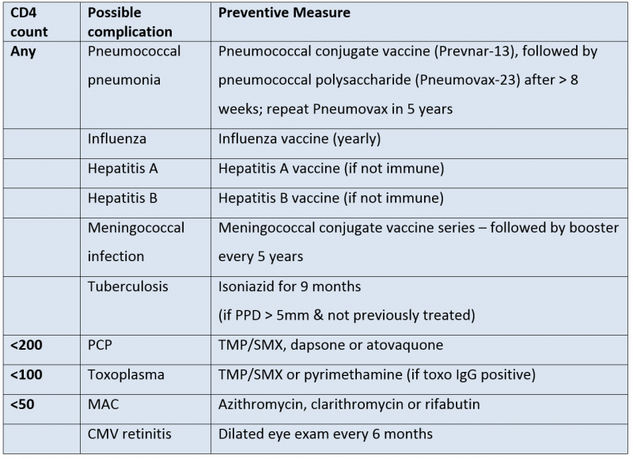
Preventative Care in HIV patients

Slide 14
Preventative Care in HIV patients Antimicrobial Prophylaxis
Pneumocystis jiroveci pneumonia (PCP) prophylaxis should be initiated when the CD4 cell count is less than 200, or if the patient already has had PCP or has oral candidiasis. Oral trimethoprim-sulfamethoxazole (TMP/SMX) is the preferred agent because it has been shown to be most efficacious and it also has the added benefit of being inexpensive (< $50/year). If patient cannot take TMP/SMX due to side effects, dapsone, aerosolized pentamidine, or atovaquone can be substituted.
All HIV-infected patients with positive tuberculin tests (defined as greater than or equal to 5 mm of induration) or close contact with someone with infectious TB, should be treated prophylactically with isoniazid 300 mg with pyridoxine 50 mg daily for 9 months. If the patient is known to have been exposed to drug-resistant TB, public health authorities should be consulted.
Patients with antibodies to Toxoplasma gondii and CD4 cell counts less than 100 cells/mm3 should be given TMP/SMX (one double-strength dose per day) for prophylaxis. Dapsone and pyrimethamine are acceptable alternatives if TMP/SMX is not tolerated.
Prophylaxis is recommended against Mycobacterium avium complex (MAC) when CD4 cell counts are less than 50 cells/mm3 and has been shown to reduce the risk of disseminated infection and overall mortality. Effective regimens include azithromycin 1200 mg once a week, clarithromycin 500 mg twice daily, or rifabutin 300 mg daily. Azithromycin and clarithromycin are more efficacious than rifabutin, and azithromycin has the added advantage of once weekly dosing.
Antiretroviral agents can raise CD4 cell counts for prolonged periods and primary (and secondary) prophylaxis can be discontinued once the CD4 cell count rises above the value used as the threshold for initiation. Discontinuation of prophylaxis for P. jiroveci, T. gondii, and MAC has been shown to be safe when patients have a sustained increase in CD4 counts above the prophylaxis threshold.

Slide 15
Question
A 42-year-old male was recently diagnosed with HIV infection and comes to see you for the first time. His CD4 count was 420 cells/ml and HIV viral load 67,000 copies/ml. He feels well and has no physical complaints. He is on no prescribed medications.
Which one of the following would be the best next step in the management of this patient?
a) Assess his readiness to take medications for his HIV infection.
b) Prescribe trimethoprim-sulfamethoxazole daily.
c) Have him return in 3 months for a repeat CD4 count and HIV viral load.
d) Prescribe antiretroviral therapy.

Slide 16
When to start therapy
The guidelines for the optimal timing of ART have evolved over the years and have favored earlier initiation of treatment as more evidence supporting this approach has become available.
The current guidelines recommend initiation of therapy for all HIV-infected individuals.
This is based on observational data indicates that earlier treatment is associated with improved survival and studies have demonstrated that ART reduces transmission among serodiscordant partners. Moreover, a 2015 clinical trial showed that earlier initiation of ART (at a CD4 count above 500) was associated with lower risk of AIDS-related and non AIDS-related serious events.
It is important to keep in mind that initiating treatment is a lifelong commitment and that patients should be prepared for this.

Slide 17
Question
Ms. Connelly is a 29-year-old woman recently diagnosed with HIV after presenting with herpes zoster. She has three children and reports a pattern of inconsistent condom usage with her current partner, whom she believes gave her HIV. She has a prior history of genital herpes with one to two outbreaks per year. She is not currently on any birth control or other medications. She does not smoke, drink alcohol or have a history of injection drug use. Physical examination is unremarkable.
Her labs reveal a CD4 count of 440 cells/mm3 and a viral load of 52,000 copies/mL. Urine hCG is negative. Genotypic resistance testing reveals no mutations. She has normal renal function and you decide to start her on a fixed combination of tenofovir DF and emtricitabine paired with either efavirenz or a boosted protease inhibitor.
Which of the following would be the most important reason to select a boosted PI over efavirenz?
a) Antiretroviral potency
b) Side effect tolerability
c) Once-daily dosing
d) Desire for pregnancy

Slide 18
Antiretrovirals
There are currently four classes of antiretroviral drugs used for initial treatment:
1. Nucleoside/nucleotide reverse transcriptase inhibitors (NRTIs). Inhibit reverse transcriptase, the HIV enzyme that converts the single-stranded RNA of the virus to a double-stranded HIV DNA.
2. Non-nucleoside reverse transcriptase inhibitors (NNRTIs). Same mechanism of action as the NRTIs, but a different chemical structure.
3. Protease inhibitors (PIs). Inhibit protease, the HIV enzyme that cuts the chains of HIV proteins used (with HIV RNA) to create new virus particles.
4. Integrase inhibitors (INSTIs). Inhibit integrase, the HIV enzyme that integrates the HIV DNA into the host cell DNA.
There are also two other classes of medications: CCR5 inhibitors and fusion inhibitors. These agents are generally reserved for “salvage therapy” in experienced patients who have developed resistance to the first-line therapies. Table 4 provides a list of the currently available antiretroviral agents that are recommended as options for initial therapy.

Slide 19
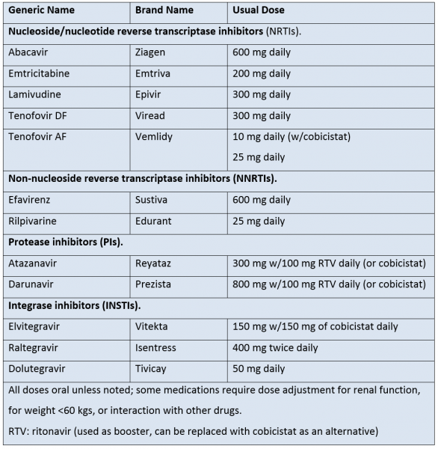
Antiretrovirals
The decision of which combination of antiretroviral medications should be used is a complicated one and should probably be only made by an experienced practitioner.
Initial therapy generally includes a “backbone” of two NRTI’s plus one of the following: an Integrase inhibitor, an NNRTI, or a PI.
Three drugs are generally used for initial therapy, although four or more may be used if patients have an inadequate response to standard three-drug regimens.
Protease inhibitors are generally boosted with ritonavir or cobicistat, which inhibit the cytochrome P450 enzyme CYP3A4 and allows for lower and less frequent dosing of other PIs. Ritonavir and cobicistat also interact with many other medications that are metabolized by the same cytochrome enzyme.
Some medications need to be dose-adjusted for renal function; this includes all of the NRTI’s, except for abacavir.
Choices of regimens are often influenced by the availability of formulations that contain two or three medications in a single pill, this allows for simplified dosing and lower pill burden. :

Slide 20
Once-daily single-pill combinations
3 regimens are combinations of 2 NRTIs and an integrase inhibitor:
Triumeq: abacavir, lamuvidine and dolutegravir
Stribild: tenofovir DF, emtricitabine, elvitegravir and cobicistat
Genvoya: tenofovir AF, emtricitabine, elvitegravir and cobicistat

Slide 21
Once-daily single-pill combinations
3 regimens are combinations of 2 NRTIs and an NNRTI
Odefsey: tenofovir AF, emtricitabine, and rilpivarine
Complera: tenofovir DF, emtricitabine, and rilpivarine
Atripla: tenofovir DF, emtricitabine and efavirenz

Slide 22
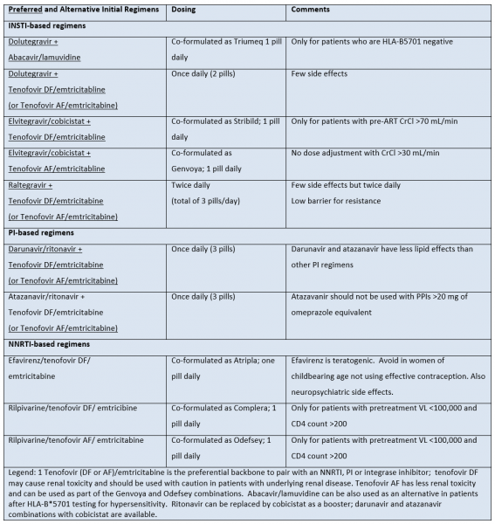
Efavirenz is teratogenic and should not be used during the first trimester of pregnancy or in women trying to conceive or not using effective birth control.
Protease inhibitor-based regimens are associated with GI side effects and lipid abnormalities.
NNRTI efavirenz is associated with rash and CNS side effects.

Slide 23
Question
A 37-year-old female is diagnosed with HIV infection during a hospitalization for pneumocystis pneumonia. Her initial CD4 count was 66 cells/mm3 and viral load 711,000 copies/ml. An HIV genotype done at the time of diagnosis shows no mutations associated with drug resistance. After initial treatment of the pneumonia, she is started on efavirenz, tenofovir DF and emtricitabine in the single-tablet daily formulation (brand name Atripla). A month after initiation of therapy, her CD4 has risen to 127 cells/mm3 and the viral load has fallen to 31,000 copies/ml. Three months after initiation of therapy, her CD4 count is 176 cells/mm3 and viral load is 5,600 copies/ml. She reports that she did run out of her medication for a few days after the first month of treatment, but has not missed any doses in the past 2 months.
What is the best next step in the treatment of her HIV infection?
a) Continue Atripla at current dose (one tablet daily)
b) Increase Atripla to two tablets daily.
c) Check a HIV genotype for resistance mutations.
d) Add raltegravir to the regimen.

Slide 24
When to change therapy
The viral load and CD4 count are both used to monitor the patient’s response to therapy
However, the viral load is the guide for deciding on changes in ART.
Changes in CD4 count may lag behind changes in viral load, particularly in patients with relatively high CD4 counts at baseline.

Slide 25
When to change therapy
Patient compliance should be reviewed whenever there is a failure in suppressing viral load to an undetectable level.
When the viral load fails to suppress or rebounds to a detectable level, resistance to one or more drugs is possible.
Transiently detectable viral loads between 50 and 500 copies/ml (“blips”) may occur and are generally not associated with drug resistance.
Compliance should be reviewed with development of strategies to improve adherence. Resistance testing should be performed to assess if any of the antiretrovirals has lost effectiveness because of viral mutations.

Slide 26
Prognostic Indicators – Viral Load
HIV viral load (HIV RNA)
On average, higher viral loads are associated with a more rapid a fall in CD4 counts and clinical disease progression
However, viral load has limited prognostic value for individual patients
The most important value of this test is to identify acutely-infected individuals and to monitor the effectiveness of antiretroviral therapy.

Slide 27
Prognostic Indicators – CD4 Lymphocytes
CD4 count: The absolute number and percentage of CD4 lymphocytes indicates of the degree of immunosuppression, and can be used to determine those complications the patient is susceptible to.
The absolute number of CD4 cells is subject to more variability than the percentage because of normal biologic fluctuations in total lymphocyte counts.
Within a year of seroconversion, CD4 cell counts usually drop 200 to 300/mm3 from the normal range of 800 to 1200.
This is followed by a slow decline of less than 100 cells per year.
People with CD4 cell counts greater than 500 are usually asymptomatic and have virtually no risk of developing an AIDS-indicator condition within 18 months, except for TB, cervical cancer, recurrent bacterial pneumonias, or superficial Kaposi sarcoma (KS).
In contrast, those with CD4 cell counts of 100 or less are often symptomatic and have a 60% chance of developing an AIDS-indicator disease within 18 months.

Slide 28
Monitoring Viral load and CD4
When ART is initiated or changed, the viral load should be monitored 2 to 4 weeks later and then at 3-month intervals to assess continued efficacy.
A 1.0 log decrease in viral load (e.g., from the hundreds of thousands to tens of thousands) should be achieved after 2 to 4 weeks of therapy.
After 12-24 weeks of therapy, the viral load should be below the level of detection (fewer than 50 copies/ml with ultrasensitive tests).
CD4 counts can be monitored less frequently (i.e. every six months or yearly) as long as they are above the threshold for prophylactic therapy (200) and the viral load is suppressed.

Slide 29
Drug Resistance
The best way to prevent development of resistance is to maximally suppress viral replication and to maintain viral suppression. Or not expose the patient to antiretroviral medications in the first place (particularly if the patient is not ready for the commitment that ART requires).
A mutation that confers resistance to a specific antiretroviral agent may also result in resistance to similar drugs that have never been used. Thus, knowledge of the cross-resistance patterns of various antiretroviral agents is important when changing therapy.
Resistance mutations are random events and the chance that a particular mutation will appear increases with higher levels of viral replication in the setting of selective pressure of a medication. The risk of development of resistance is directly related to a patient's compliance in taking the prescribed dosage at the appropriate time. Taking antiretrovirals at a reduced dosage results in drug levels at which selection for drug-resistant variants can occur. Likewise, taking only one or two antiretrovirals increases the chance that the virus may become resistant to one or both.
Resistance testing is most useful in two situations:
Patients with newly diagnosed HIV infection to detect transmission of resistant virus
Patients on ART who are failing therapy (i.e., viral load is detectable despite treatment) to guide decisions regarding therapy changes.

Slide 30
Drug Resistance
Keep in mind that resistance testing only gives reliable information about drugs a patient is currently taking; a patient may have virus with resistance mutations to certain drugs (particularly if they have been exposed to them previously), which may not be detected in the absence of the selective pressure of taking that drug. Results of resistance testing must be considered in conjunction with knowledge of what antiretrovirals the patient has taken in the past. Phenotypic resistance testing may be useful in situations where patients have multiple genotypic resistance mutations.
Genotypic resistance testing is costly (~U.S. $300 to $500), but this expense is negligible when compared with the cost of continuing ineffective antiretroviral medications.
The viral load usually has to be above 1,000 copies/mL for the test to be performed
Results are generally reported as a series of mutations identified by a letter-number-letter sequence (e.g., M184V). The number is the codon where the mutation has been detected, the first letter is the wild-type amino acid at that codon, and the last letter is the amino acid that has been substituted for it (i.e., M184V is a replacement of methionine with valine at the 184 codon).
Interpretation of genotypic resistance testing is complex because some isolated mutations confer high-level resistance to a medication, whereas in other cases multiple mutations or specific combinations of mutations are needed for resistance to develop. Updated databases of resistance mutations are available through a number of Internet sites, including the one maintained by the International AIDS Society-USA (www.iasusa.org).
If noncompliance is contributing to resistance, a new ART regimen should not be prescribed until obstacles to compliance are addressed and resolved.

Slide 31
Question
A 49-year-old male with HIV infection is on a regimen of two NRTIs in the form of Combivir (lamivudine and zidovudine) with the protease inhibitor Kaletra (lopinavir/ritonavir). He is doing well and has had consistently undetectable viral load with rising CD4 count. His fasting lipid panel shows total cholesterol of 269 mg/dl with an HDL of 40 mg/dl and LDL of 179 mg/dl and triglycerides 250mg/dl. He smokes cigarettes, but has no other risk factors for coronary artery disease.
Which ONE of the following would be the best course of action for this patient?
a) Prescribe simvastatin 40 mg daily.
b) Change regimen to Truvada (tenofovir DF/emtricitabine) + Tivicay (dolutegravir)
c) Continue current regimen and provide dietary advice to lower cholesterol.
d) Replace lopinavir/ritonavir with ritonavir-boosted fosamprenavir.

Slide 32
Discussion
Hyperlipidemia is associated with most of the protease inhibitors, including lopinavir/ritonavir.
He is at high risk for cardiac disease, so his regimen should be changed or he should be started on a statin (or both).
Changing INSTI-based regimen should help with his lipids.
Changing or replacing the lopinavir/ritonavir with ritonavir-boosted fosamprenavir, or replacing the NRTIs would not help.
Simvastatin should not be prescribed because its metabolism is inhibited by ritonavir and this can lead to toxicity; pravastatin or atorvastatin can be prescribed with ritonavir.

Slide 33
Question
A 53-year-old female is found to be HIV infected with a CD4 count of 88 cells/mm3. She is started on Atripla (tenofovirDF, emtricitabine and efavirenz) and TMP/SMX. Her creatinine at the time of diagnosis is 1.1 mg/dL. A year later, her CD4 count has risen to 252 cells/mm3
Her creatinine has also risen to 1.4 mg/dL and remains at that level after TMP-SMX is discontinued.
Which ONE of her medications is the most likely cause of her increase in creatinine?
a) Tenofovir DF
b) Emtricitabine
c) Efavirenz
d) TMP-SMX

Slide 34
Side Effects Renal Adverse Effects
The NRTI tenofovir DF (brand name Viread, also a component of Truvada, Atripla, Complera and Stribild) is associated with renal toxicity that may occur weeks to months after initiation of therapy; severe toxicity is rare.
Tenofovir DF has also been associated with cases of Fanconi’s syndrome, which typically presents with hypokalemia, hypophosphatemia and normal anion gap metabolic acidosis.
A newer formulation of tenofovir - tenofovir alafenamide or AF (a component of Descovey, Genvoya, and Odefsey) has less renal toxicity and will likely take the place of tenofovir DF and combination products with it.

Slide 35
Neurologic Adverse Effects
Most patients who take efavirenz (brand name Sustiva and a component of Atripla) experience some CNS side effects, including drowsiness, dizziness, abnormal dreams, impaired concentration and exacerbation of psychiatric disorders.
Taking efavirenz at bedtime may help minimize these side effects. These side effects are usually mild and subside in the first 2-4 weeks, but may be severe or persistent and require discontinuation of the medication.
A recent analysis of trial data found a significant increase in the risk of suicidality among individuals who were prescribed efavirenz; the relative risk was about twice that of others, but the absolute increase was modest (about 1 additional individual/year with suicidality for every 226 prescribed).

Slide 36
Cardiac Adverse Effects
A number of studies have found an association between antiretroviral therapy and the risk of myocardial infarction.
The drugs implicated include the protease inhibitors as well as the NRTI abacavir (Ziagen). The data is primarily from observational studies and is not consistent over all studies.
The protease inhibitors are thought to increase the risk of myocardial infarction at least partly through their effects on lipids. The increased risk observed with abacavir cannot be explained by lipid changes.
The DHHS guidelines recommend managing other risk factors for cardiovascular disease and avoiding these agents in patients with or at high risk for cardiovascular disease.

Slide 37
Gastrointestinal and Hepatic Adverse Effects
Nausea, vomiting and diarrhea, are common side effects with many agents, including all of the PIs.
Patients should be advised that the symptoms may get better with time. Taking the medication with food may help with these side effects, although some medications are recommended on an empty stomach. Taking antiemetics or antidiarrheals may help control the symptoms.
Hepatotoxicity in the form of clinical hepatitis or asymptomatic elevations in liver enzymes has been reported with all of the NNRTIs, most NRTIs and the CCR5 inhibitor maraviroc (Selzentry).
The protease inhibitor, atazanavir (Reyataz) is associated with a unconjugated hyperbilirubinemia; like the hyperbilirubinemia of Gilbert’s, this is clinically benign and a change of therapy is not generally needed, but it may cause jaundice in some individuals with a genetic predisposition.

Slide 38
Endocrine and Metabolic Adverse Effects
All of the PIs are associated with hyperlipidemia, except for atazanavir when used alone (i.e. without ritonavir boosting).
Antiretroviral medications are also associated with fat redistribution.
Tenfovir DF has been associated with bone loss and osteoporosis; a new formulation, tenofovir AF, appears to have less effect on bone density.

Slide 39
Cutaneous Adverse Effects
Rash is a side effect of the NNRTIs. Rash usually occurs a few days or weeks after initiation of therapy and may progress to Stevens-Johnson syndrome and toxic epidermal necrosis.
Less severe rash has also been reported with most of the PIs.

Slide 40
Hypersensitivity Reaction
Abacavir (brand name Ziagen, also part of the combination pills Epzicom and Triumeq) is associated with a hypersensitivity reaction that usually occurs in the first week or two of taking the medication.
Symptoms include fever, rash, headache, myalgias, diarrhea, vomiting, and abdominal pain, and may progress to hypotension, respiratory distress and death, especially if the medication is continued or the patient is rechallenged after an initial reaction.
Most cases occur in individuals who are HLA B*5701 positive, and it is recommended that everyone be screened for this prior to prescribing abacavir (or any of the combination products that contain abacavir).
Patients should not be rechallenged with this drug if a hypersensitivity reaction is suspected, even if they are HLA B*5701 negative.

Slide 41
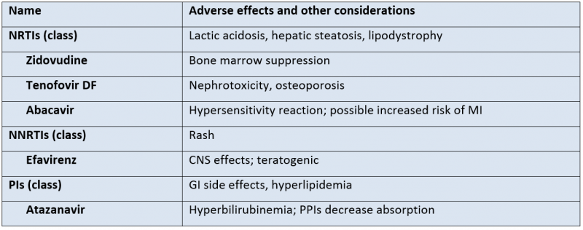
Drug Interactions
The most important drug interactions are those with the ritonavir and cobicistat, which are potent inhibitors of the cytochrome P450 enzyme CYP3A4.
They are used for this reason to boost other antiretrovirals, particularly protease inhibitors, but also the integrase inhibitor elvitegravir.

Slide 42
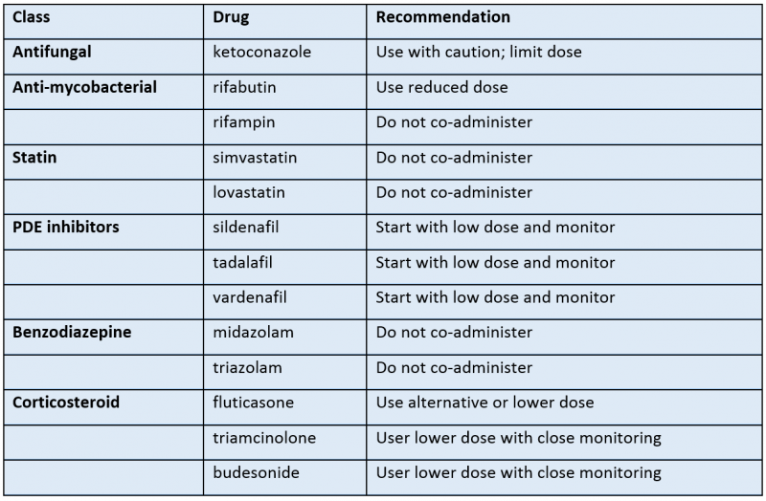
Drug Interactions
The effects of ritonavir and cobicistat on the cytochrome P450 enzyme CYP3A4 also lead to numerous potential interactions with other drugs that are metabolized by this pathway. Most of the experience and data is with ritonavir, but it is assumed that cobicistat will have the same interactions.
These drugs include the antifungal ketoconazole, the antimyobacterials rifabutin and rifampin, the benzodiazepines midazolam and triazolam, the HMGcoA reductase inhibitors (i.e. statins) lovastatin and simvastatin, and all of the phosphodiesterase inhibitors (sildenafil, tadalafil, and vardenafil).
Ritonavir can also reduce the metabolism of a number of corticosteroids; there have been reports of iatrogenic Cushing's syndrome associated with the concurrent use of inhaled/intranasal fluticasone, inhaled budesonide, and triamcinolone injections; most of the reports have been with fluticasone.
The guidelines recommend that some of these drugs not be given with ritonavir (including rifampin, midazolam, triazolam, lovastatin and simvastatin); for other drugs, reduced starting dose and closer monitoring are generally recommended.

Slide 43
Drug Interactions
An important drug interaction is between medicines that lower stomach acid and the PI atazanavir (Reyataz) as well as the NNRTI rilpirvirine (Edurant, also a component of the combination pills Complera and Odefsey).
It is recommended that proton pump inhibitors not be used with these drugs, particularly if the atazanavir is not boosted with ritonavir.
H2 blockers and antacids may be used with caution with atazanavir or rilpivarine, but it is recommended that they be spaced out; specific instructions are provided in the guidelines.
With the introduction of newer, more effective treatments for hepatitis C, co-infected patients are increasingly being treated. There are a number of drug interactions to consider and contraindicated combinations, particularly with ritonavir/cobicistat and efavirenz.

Slide 44
Summary
HIV has increasingly become a treatable chronic illness. However, the treatment is complex and requires much higher levels of patient adherence than other chronic illnesses.
Successful treatment requires a knowledgeable practitioner working closely with an engaged and adherent patient over many years

Slide 45
Thank You
Always encourage safe sex!

