Slide 1
Immunizations Part II
Khaled Janom
Ambulatory report

Slide 2
Outline
Hepatitis A Vaccine
Hepatitis B Vaccine
HPV Vaccine
Varicella Vaccine
Zoster Vaccine

Slide 3
Hepatitis A
ABOUT THE VIRUS:
RNA (picornavirus) that infects the liver after fecal-oral transmission
Incubation to clinical manifestation is 28 days
Transmission: person to person (fecal-oral, including household and sexual). Transmission via contaminated water or food is less common.
Individuals are most infective PRIOR to clinical manifestations: shedding in stools is highest 2 weeks prior to liver enzyme elevation or jaundice.

Slide 4
Children and Hepatitis A infection
Children play an important role in transmission of the Hepatitis A in the community
Household with children less than 6 years old are at increased incidence of Hepatitis A infection
Children are more likely to have an asymptomatic infection than adults, thus greater risk of viral spread

Slide 5
Morbidity/Mortality of Hepatitis A infection
Hepatitis A has a very low case fatality rate (0.3%)
Fatality is increased in individuals over age 50
Chronic liver disease patient have both increased fatality risk and higher rate of fulminant hepatitis
Hepatitis A does not cause chronic hepatitis

Slide 6
Hepatitis A Vaccine
First licensed in 1995 and prepared from cultured and inactivated hepatitis A virus that is entirely killed
First the vaccine was recommended only for groups at high risk of infection: - Men who have sex with men - Travelers to endemic regions - Injection drug users - Recipients of clotting factors - Chronic liver disease patients
Introduction of the vaccine has led to historic lows of hepatitis A infection in the US

Slide 9
Efficacy of Hepatitis A Vaccine
The hepatitis A vaccine is very effective at inducing the production of protective antibodies.
One month after a single dose of the vaccine, protective antibodies are found in 94-100% of adults
Production of protective antibodies is universal after two doses.

Slide 10
Administration
The vaccine should be administered intramuscularly in the deltoid, and is repeated 6 months after the initial vaccination
If the second dose is missed, there is no need to restart the series; simply administer the second dose at a later date
The vaccine is thought to induce long-lasting immunity, so no additional booster is required
The vaccine may be administered with other vaccines.

Slide 11
Contraindications and Precautions
The vaccine is generally very well tolerated and the only contraindication is a previous anaphylactic reaction to this vaccine or to any of its components
Like all vaccines, moderate or severe acute illness should delay vaccination
The safety of hepatitis A vaccine during pregnancy has not been established, so benefits of vaccination must be weighed against potential risks

Slide 14
Hepatitis B
ABOUT THE VIRUS:
DNA virus (Hepadnavirus) that infects the liver after transmission through percutaneous or mucosal exposure to infectious blood or body fluids (serum, saliva, semen)
In adults: HBV transmission occurs primarily among unvaccinated persons with behavioral risks: - Heterosexuals with multiple sex partners - Injection drug users - Men who have sex with men - Household contacts or sexual partners of those with chronic HBV

Slide 15
More about the infection
The incubation period after exposure averages 60 days until ALT elevation, and 90 days until jaundice
Young children (especially under age 5) and immunosuppressed individuals may remain entirely asymptomatic after infection
The case fatality rate is 0.5-1%, but is higher in the elderly
Chronic infection in healthy adults is uncommon (<5%), but much higher in the immunosuppressed and in those with diabetes
Chronic infection is much higher when young children are infected, and nearly universal in infants.

Slide 16
Hepatitis B Vaccine
1987: a vaccine of inactivated hepatitis B surface antigen particles produced by genetically engineered yeast has been available
When first implemented, the hepatitis B vaccine was targeted towards high- risk groups (hemodialysis patients, recipients of blood products, men who have sex with men)
After several years of implementation, many high-risk patients had not been vaccinated, and in 1991 it was decided to expand targeted groups in order to prevent spread of infection
1991: universal childhood vaccination was recommended.
1995: vaccination of all adolescents aged 11-12 who had not previously been vaccinated was recommended.
1999: vaccination of all adolescents <19 who had not previously been vaccinated was recommended (as a result, most adults born after 1980 will have been immunized against HBV)

Slide 19
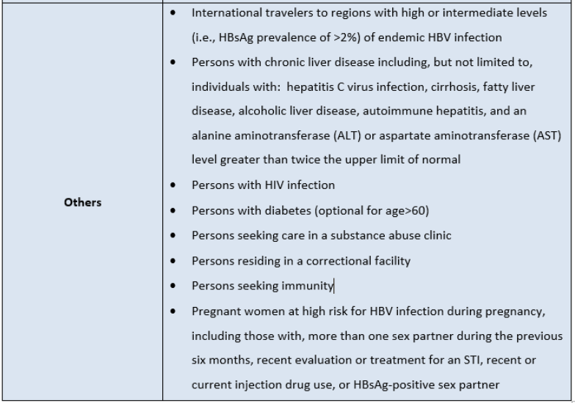

Slide 20
Dosing of Hepatitis B Vaccine
The dosing schedule for the hepatitis B vaccine is at 0, 1 and 6 months
Accelerated schedule of 0, 1 and 4 months is acceptable
It is not necessary to restart an interrupted series. That is, if one of the doses is delayed past the recommended interval, it may be given without loss of efficacy
Doses given before the recommended interval, however, must be repeated
Adults receiving hemodialysis or other immunocompromised adults (e.g., HIV-infected persons, hematopoietic stem-cell transplant recipients, and patients undergoing chemotherapy) should receive double the amount (40 micrograms) per vaccine dose
Individuals allergic to baker's yeast, or if they have had a severe allergic reaction after a previous dose or to a vaccine component, should not get the hepatitis B vaccine

Slide 21
Pre-vaccination Serologic Testing
Pre-vaccination testing is recommended for high-risk groups including:
Anyone born in Africa, Asia, and the Pacific Islands
Men who have sex with men
Injection drug users
Household, sex, and needle-sharing contacts of known persons with chronic hepatitis B
If you are planning to vaccinate a person that doesn’t belong to one of these groups, pre-vaccination serologic testing for hepatitis B exposure is not recommended

Slide 22
Post Vaccination Serologic Testing
Immune response should be considered for people whose subsequent management depends on knowledge of their immune status:
Healthcare workers
Chronic hemodialysis patients
Immunocompromised persons including persons with HIV infection
Sex partners of HBsAg positive persons
When necessary, post-vaccination testing should be performed 1–2 months after completion of the vaccine series.

Slide 25
Human Papilloma Virus (HPV)
ABOUT THE VIRUS:
Double Stranded DNA Virus (Papillomaviridae)
Spread through sexual intercourse
Genital HPV is the most common sexually transmitted infection in the United States
Although the majority of infections clear in 1 year (and 90% clear in 2 years), HPV is associated with the development of genital warts and anogenital cancer
There are several different serotypes of HPV. Each serotype is associated with a different level of risk of causing either genital warts or cervical cancer. Serotypes 6 and 11 are the most common causes of genital warts. Serotypes 16 and 18 are the most common causes of cervical cancer

Slide 26
HPV Vaccine
June 2006: the first vaccine against HPV was licensed for use
The vaccine, brand name Gardasil, is a quadrivalent recombinant surface protein comprised of the HPV L1 protein from 4 serotypes of HPV (6 and 11, to protect against genital warts; 16 and 18, to protect against cervical cancer, HPV4)
In February 2015, the ACIP recommended a 9-valent human papillomavirus (HPV) vaccine (9vHPV) (Gardasil 9) as one of two HPV vaccines that can be used for routine vaccination. The 9-valent vaccine targets five more strains than the quadrivalent version, and these five strains (31, 33, 45, 52, and 58) cause roughly 15% of cervical cancers.

Slide 27
Females and the Vaccine
Adult females up to age 26 years who initiated the HPV vaccine series before the age of 15 years and received 2 doses at least 5 months apart are considered adequately vaccinated
Those individuals who received only 1 dose, or 2 doses less than 5 months apart are not considered adequately vaccinated and should receive 1 additional dose of the HPV vaccine
HPV vaccination does not change recommendations for cervical cancer screening

Slide 28
Males and the Vaccine
Efficacy studies in men have shown benefit in provoking an immune response and in preventing anal cancer caused by HPV types 16 and 18, and the prevention of anal intraepithelial neoplasia (grades 1, 2, and 3) caused by HPV types 6, 11, 16, and 18
Adolescent and young adult males ages 11-21 should receive the HPV4 or HVP9 vaccine series and if they received 2 doses at least 5 months apart before the age of 15 years are considered adequately immunized
Men ages 22-26 that are immunocompromised, HIV positive, or have sex with other men should also be immunized with 3 doses (men aged 22-26 may be vaccinated with a 3 dose series of the HPV vaccine).

Slide 30
Varicella
ABOUT THE VIRUS:
Herpes virus that causes varicella (primary infection) and zoster (reactivation)
The virus is transmitted from person to person by direct contact, inhalation of aerosols from vesicular fluid, or infected respiratory tract secretions
The incubation period is 14-16 days, and an individual becomes contagious 1-2 days before the onset of rash
Individuals remain contagious until all lesions are crusted over
After primary infection the virus becomes dormant in sensory nerve ganglia

Slide 31
Varicella Vaccine
Varicella vaccine is a live attenuated virus vaccine of the varicella virus, and is among the standard immunizations given to children
Originally licensed in 1995, the majority of adult patients have not received varicella vaccine
The vaccine is quite effective at preventing severe infection with varicella (efficacy approaches 100%); its efficacy at complete prevention of infection is somewhat lower
Since the introduction of varicella vaccination, the incidence of varicella has declined dramatically

Slide 32
Indications
Prior to 1980, childhood varicella was so common that adults born prior to 1980 are usually considered immune
A personal recollection of past infection (of either varicella or zoster) is a strong predictor of immunity, but blood tests to demonstrate immunity are recommended if there is doubt
All healthy adults should be assessed for varicella immunity, and if not immune, should be vaccinated
Two doses of vaccine are needed, at 0 and 4-8 weeks
If the second shot is delayed, there is no need to restart the series. There is no need for routine post-vaccination testing
Salicylates should be avoided following varicella vaccine to avoid Reye's syndrome.

Slide 33
Post Exposure Prophylaxis
If a non-varicella immune individual is exposed to someone with contagious varicella, that individual should be vaccinated with varicella vaccine within 3 days of exposure
In children this has been shown to be more than 90% effective at preventing varicella
If varicella vaccine is contraindicated (e.g., in pregnant or immunocompromised hosts), varicella zoster immune globulin should be used for post exposure prophylaxis

Slide 34
Zoster Vaccine
In 2006, the FDA approved use of strengthened live attenuated varicella virus vaccine for the prevention of zoster in individuals with a history of varicella, after a large study demonstrated a 51% decrease in the incidence of zoster and 66% reduction in the incidence of post-herpetic neuralgia in immunized patients
One in three individuals with a history of varicella will eventually develop zoster, with 1 million cases of zoster in the United States alone.
Between 10 and 20 percent of individuals with zoster will develop post-herpetic neuralgia. The zoster vaccine reduces the risk of zoster, and it also reduces the risk of post-herpetic neuralgia in vaccinated patients who develop zoster.

Slide 36
Thank You ☺

