Slide 1
Smoking

Slide 2
Objectives
Epidemiology of smoking
The effects of nicotine and nicotine withdrawal
Medical Complications of smoking
Counselling patients who smoke
Pharmacotherapy and other interventions for smoking cessation

Slide 3
Phillip Morris is an 18 year-old high school student sees you to have forms filled out for college. He says that he smokes occasionally when he hangs out with his friends.
Which ONE of the following statements about the epidemiology of smoking in the U.S. is correct?
a) Smoking rates among men and women are roughly equivalent.
b) Smoking rates are highest among those aged 30-40.
c) There is no association between smoking and level of education.
d) Most smokers begin before the age of 18.

Slide 4
Phillip Morris is an 18 year-old high school student sees you to have forms filled out for college. He says that he smokes occasionally when he hangs out with his friends.
Which ONE of the following statements about the epidemiology of smoking in the U.S. is correct?
a) Smoking rates among men and women are roughly equivalent.
b) Smoking rates are highest among those aged 30-40.
c) There is no association between smoking and level of education.
d) Most smokers begin before the age of 18.

Slide 5
Epidemiology of smoking
Smoking is the single most cause of preventable mortality and morbidity in the United States.
According to 2013 national survey on drug use and health 26% of the population over 12 year age reported current use of tobacco products.
Cigarette smoking is highest among 18-25 year of age.
Overall smoking is more prevalent in males (31%) than female (20%).
But in adolescents rates among male and female are roughly equal.

Slide 6
Factors involved in smoking
Peer factors (Having friends who smoke)
Family factors( Smokers in family, family conflicts and poor communication)
Personal factors ( Learning problems, depression and antisocial behavior)
Tobacco industry promotional activities.
Increasing the cost of cigarettes through taxation and mandating smoke free workplace is found to be helpful to reduce smoking.

Slide 7
A 21 year-old college student tells you he likes to smoke because it makes him feel more alert and helps him "relax". He is sure that he will not become addicted.
Which ONE of the following statements about the effects of nicotine is correct?
a) Nicotine is a mild sedative.
b) Nicotine impairs short-term memory.
c) Nicotine is an appetite suppressant.
d) Nicotine toxicity may lead to seizures and coma.

Slide 8
A 21 year-old college student tells you he likes to smoke because it makes him feel more alert and helps him "relax". He is sure that he will not become addicted.
Which ONE of the following statements about the effects of nicotine is correct?
a) Nicotine is a mild sedative.
b) Nicotine impairs short-term memory.
c) Nicotine is an appetite suppressant.
d) Nicotine toxicity may lead to seizures and coma.

Slide 9
Acute effects of nicotine
Nicotine is psychoactive component of tobacco and is responsible for habit forming.
Nicotine acts on selective acetyl choline receptors (nicotine receptors) and produces mild stimulating effects ( Increased alertness, improved attention, decreased appetite)

Slide 10
Acute effects of nicotine cont:
Nicotine overdose is very rare in regular users ,but can be seen in children exposed to nicotine patches or ingested tobacco manifesting in the form of nausea, vomiting, diarrhea, weakness, dizziness.
Potential therapeutic effects of nicotine- In elderly non smokers nicotine patches are reported to improve short term memory and nicotine is also beneficial for treatment and prevention of ulcerative colitis.

Slide 11
Nicotine withdrawal
In first few days of abstinence, there is craving for tobacco, irritability, anxiety, difficulty in concentration, restlessness, slowing of heart rate
and increased appetite
The withdrawal S/S are more intense in the first few days and then decline gradually over the first month except weight gain and increased appetite which can persist up to several months.

Slide 12
After advising Mr. Morris clearly that he should quit smoking, you decide to counsel him briefly on the complications of smoking.
Which ONE of the following statements about the medical complications associated with smoking is correct?
a) Obstructive lung disease is the leading cause of premature death due to smoking.
b) Smokers are at increased risk for pneumonia, tuberculosis and influenza.
c) Smoking increases the risk of coronary artery disease, but not aortic aneurysms.
d) Smoking increases the risk of ulcerative colitis.

Slide 13
After advising Mr. Morris clearly that he should quit smoking, you decide to counsel him briefly on the complications of smoking.
Which ONE of the following statements about the medical complications associated with smoking is correct?
a) Obstructive lung disease is the leading cause of premature death due to smoking.
b) Smokers are at increased risk for pneumonia, tuberculosis and influenza.
c) Smoking increases the risk of coronary artery disease, but not aortic aneurysms.
d) Smoking increases the risk of ulcerative colitis.

Slide 14
Medical Complications of smoking
There are 5 million excess deaths occur every year world wide due to smoking . Most of them are due to cardio vascular diseases followed by COPD and Ca lung. The mortality rate in former smoker decreases significantly within 5 years of smoking cessation and to the level of never smokers after20 years of quitting smoking. The mortality due to CVD decreases more rapidly after smoking cessation
Cardio Vascular Complications: CAD due to endothelial impairment and adverse affects on lipid profile, PVD, aortic aneurysm.
Pulmonary Complications: COPD, Ca Lung (The risk increases with duration of smoking and number of cigarettes smoked), increased risk and severity of lung infections like TB, pneumonia and influenza.

Slide 15
Complications Cont:
Gastrointestinal Complications: Esophageal Ca (both squamous and adenocarcinoma), Ca pancreas, PUD (Smoking has synergistic effect with H pylori infection), GERD.
Genitourinary Complications: Smoking accelerates decline in renal function especially in elderly and diabetics, increases the risk of renovascular diseases, RCC and Bladder cancer, erectile dysfunction in males.
Head and Neck Complications: Increased risk of squamous cell Ca of head and neck, Premature aging of skin and increased facial wrinkling( Due to combined effect of smoking and sun exposure)

Slide 16
A 32 year-old school teacher sees you for a routine physical exam. He has no complaints and denies having any significant medical problems in the past. He does smoke a pack of cigarettes each day, but has not thought about quitting.
Which ONE of the following interventions is most likely to be effective at getting this patient to quit smoking?
a) Providing him with detailed educational materials.
b) Providing brief advice that includes a clear statement that you feel he should quit.
c) Recommend that he schedule an appointment when he is ready to quit.
d) Warning him of the dangers of smoking and showing a picture of a smoker's lung.

Slide 17
A 32 year-old school teacher sees you for a routine physical exam. He has no complaints and denies having any significant medical problems in the past. He does smoke a pack of cigarettes each day, but has not thought about quitting.
Which ONE of the following interventions is most likely to be effective at getting this patient to quit smoking?
a) Providing him with detailed educational materials.
b) Providing brief advice that includes a clear statement that you feel he should quit.
c) Recommend that he schedule an appointment when he is ready to quit.
d) Warning him of the dangers of smoking and showing a picture of a smoker's lung.

Slide 18
Treatment modalities in smoking cessation
Different types of counselling Physician advice, Nurse delivered counselling and education, telephone counselling , pharmacotherapy are effective to stop smoking but no intervention is effective independently to stop smoking and smokers has to make multiple attempts before they are able to quit smoking.

Slide 19
Behavioral therapy
2013 Cochrane review concluded that physician advice has a small effect on smoking cessation.
Meta analysis from various studies has shown that a brief physician advice increases the relative risk of smoking cessation when compared to no advice at all.
Nurse delivered counselling and education also appears to have a small but significant effect on smoking cessation.
Telephone counselling has also been shown to be effective, especially if patients receive multiple sessions of call back counselling.

Slide 20
Behavioral therapy cont:
Group behavioral therapy includes various components such as motivational enhancement, advice on relapse prevention, coping skills, relaxation techniques, stress management and cognitive behavioral therapy.
Cochrane review of group therapy has shown it effective than self help and others less intensive therapies.
Individual counselling utilizes approaches same as in group therapy but is given in one to one setting.
In studies this approach has been shown to be effective but not more than group therapy

Slide 21
You see a 32 year-old male for an acute visit for an upper respiratory infection. He smokes about a pack per day. You advise him that smokers are at increased risk for respiratory infections. Which ONE of the following measures would be the best next step to getting this patient to quit smoking?
a) Refer him to a smoking cessation program.
b) Assess his readiness to quit smoking.
c) Prescribe varenicline (Chantix).
d) Ask him to schedule another appointment to discuss his smoking.

Slide 22
You see a 32 year-old male for an acute visit for an upper respiratory infection. He smokes about a pack per day. You advise him that smokers are at increased risk for respiratory infections. Which ONE of the following measures would be the best next step to getting this patient to quit smoking?
a) Refer him to a smoking cessation program.
b) Assess his readiness to quit smoking.
c) Prescribe varenicline (Chantix).
d) Ask him to schedule another appointment to discuss his smoking.

Slide 23
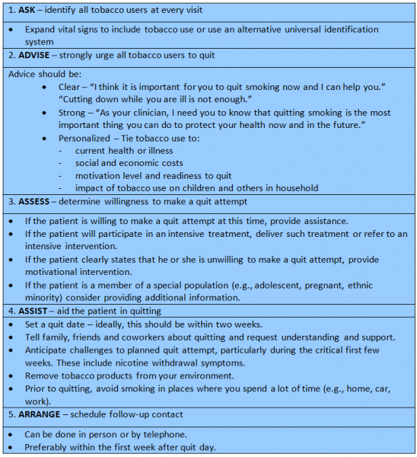
Counselling to smokers : US DHHS recommendations for counselling of smokers

Slide 24
Pharmacotherapy
Nicotine replacement therapy
Varenicline
Antidepressants
Electronic cigarettes

Slide 25
Nicotine replacement therapy
Can be given in variety of forms including gums, patches, nasal sprays, inhalers, sublingual tablets/lozenges.
Most of studies have shown that nicotine replacement therapy increases smoking cessation rate by 60%.
Duration of therapy used in most of studies is 12 weeks, however there is no additional benefit of using NRT beyond 8 weeks.
Abstinence during first 2 weeks of therapy is the best predictor of long term abstinence.
No form of NRT has been shown to be effective over the other .

Slide 26
Nicotine replacement therapy
Use of higher doses of nicotine gum(4mg) appears to be more effective for highly dependent smokers ( defined by number of cigarettes smoked and time to first cigarette in the morning.
Similarly higher doses of nicotine patches are more effective for heavy smokers (Using more than 1 and ½ pack /per day).

Slide 27
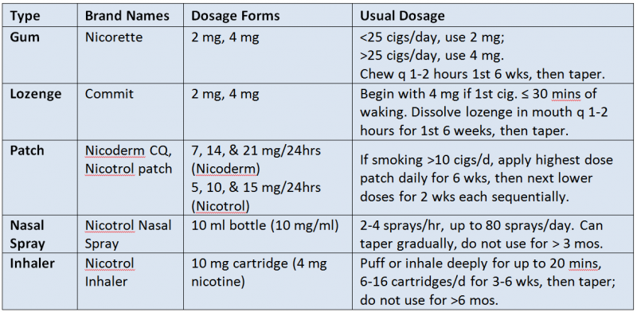
Nicotine replacement therapy

Slide 28
Varenicline
It is a nicotinic acetylcholine receptors partial agonist which works by reducing the craving for nicotine while blocking the effects of smoked nicotine.
In some of recent studies it has been shown to be more effective than bupropion and even nicotine replacement therapy but not in all studies..
Usual dose is 1 mg bid. Dose is started as 0.5 mg daily for 3 days, then 0.5 mg bid for next 3 days, followed by 1 mg daily and is continued for 12 weeks
For smokers who are able to achieve abstinence on varenicline therapy continuation of treatment beyond 12 weeks is helpful in maintaining abstinence from smoking.
For patients who are unable to quit with standard doses using higher doses does of varenicline does not improve smoking cessation rates.

Slide 29
Side effects of varenicline:
Side effects of varenicline therapy: Nausea is the MC side effects shown in studies but it is diminished over time.
In some studies severe neuropsychiatric side effects like change in behavior, agitation, suicidal ideation ,attempted and completed suicide but was later on ruled out by a large cohort study done on 80660 smokers.
Few cardiovascular side effects have been shown in few studies but meta analysis did not show any CV side effects of verenicline.

Slide 30
Antidepressants
Bupropion and nortriptyline are effective but Venlafaxine and other SSRI are not.
Bupropion is FDA approved for smoking cessation and is generally considered the treatment of choice as most of the studies has been done with it.
Long term treatment (A year or longer)with antidepressants is helpful to reduce relapse rate.
Side effects of bupropion : Insomnia, Headache and increased risk of seizures.
Nortriptyline side effects: Sedation and dry mouth.
Dose: of nortriptyline used in trials was 50-150 mg /day (Most used 75 mg/day), of bupropion dose used was 150-300 mg/day (Most used 300 mg /day in 2 divided doses).

Slide 31
Electronic cigarettes
E cigarettes are battery powered new devices deliver a nicotine vapor that is inhaled by the user.
These are marketed as a safe alternative to the smokers, that can be used in settings where smoking cigarettes is prohibited.
In trials there has been no adverse effects noted with E cigarettes but long term safety of these devices has not been established.
There are toxic substances in these vapors but at much lower levels than found in tobacco smoke.

Slide 32
In summary, smoking has a tremendous impact on the health of our patients; therefore it is very important that physicians identify smokers, counsel them on the risks of smoking, assess their readiness for quitting and provide them with effective treatment for tobacco dependence.

Slide 33
Thank You

