Slide 1
Detroit VA Medical Center Department of Medicine Pearls for Patient care processes

Slide 2
Care Coordinators
We now have 3 RN care Coordinator to help you coordinating care; Medicine Care coordinators: Catherine Ramsey 62717; pager red team Tonya Ackles 62775 green team : blue team Wendy Johnson ; Tammy King Yellow team 62703 Care coordinators can help with complex processes (i.e.. Setting up home antibiotics and discharges) They will round with you each day
Social work is also a great resource. As of now, we have 2 full time social worker, Matt Brown and Michelle Crossley . We are short 2 regular social workers We have a part-time weekend social worker: Chad ext. 63203; weekend pager is 61135-9667

Slide 3
Nurse Practitioners
To support and help medical team
One NP only for Jan. Feb.
Currently this role in flux. There are two vacancies. With two new hires pending.
NP Lavone McCullough pager: 280-0106 Her responsibilities will be adjusted as she is only NP for now.
;

Slide 4
Np roles on medicine teams
NP will carry the admission pager from 8am to 1pm on weekdays a week at a time: duties: triage for level of care; see pt.; write initial orders; then distribute patients at 1pm..also takes limited overflow admissions. She also is the day person for medicine consults. However as there are two new NPs pending. Residents and attending may be assigned consults. Current NP will have limited space for overflows, depending on consult list.
NP role in flux and will likely be redesigned when two new NPs are on service.

Slide 5
ASSIGNMENT OF OVERFLOWS
OVERFLOWS ARE ANY PATIENT THAT IS ADMITTED AFTER THE ONCALL TEAM CAPS AT 9. THESE CAN BE MOD OR NIGHT FLOAT PATIENT: NP may help with overflows mon-fri; however d/t there being only one NP for now; residents likely will be taking more overflows.
If the on call team does not cap they take MOD admissions to their cap of 9
Please bring admission log from prior day to NP office by 8am.tp determine if NP has room for overflows. If not they will be assigned to resident team. IF NP taking overflow/ order will be Pre-call, post- post call , on-call; If only one NP on service. Likely can absorb only 2 or 3 at max overflows.
On weekends; the pre-call and post, post call take all the overflows. Post call and on call team does not take overflow.

Slide 6
precertification
Every patient must have a bed assigned and at least initial
orders before precert. Can occur; admitting provider; i.e..
ER, oncology, ICU,GI , etc. must obtain bed before calling you
with and admission; they should write initial admit order; i.e..
ER bridge orders.
Required for:
All acute care admissions
Transfers to higher level of care
Transfers to or from B2 (Inpt Psychiatry)
Converting pt. from Observation for full admission
Should be done by admitting provider; We should do for transfers
and readmissions to full admit
Call Precertification Nurse; ext. 62730/ off tour at night 62726
Precertification occurs AFTER admission or transfer orders are completed
After hours, contact Nursing Supervisor

Slide 7
Admissions; Er bridge orders
Do not write your own set of delayed orders
for ER
If you see patient before orders are released
you may add orders to ER bridge orders but
must add them one by one. go to immediate to
admission orders and add all your patient care
orders; diet etc.
Note: you may not d/c ER bridge orders; you may not write your own set of delayed orders.
If patient is admitted in “visit selected” to a bed
you can write active orders, . You can then transfer outpt. meds to inpatient orders.

Slide 8
Immediate admission order set
Currently you have all orders needed for admission
You can use this for all your patient care orders. You can use this for delayed and active orders (you may add these to ER bridge orders
Important orders include are: anticipated discharge, team color, labs, vitals, iv fluids, meds . VTE prophylaxis , radiology orders, diet… again all in one place. Makes your VAMC life easier. Go to CPRS, orders tab. Scroll down under specialty menu and you choose immediate admission menu
Order sets that were found under this menu in the past are now under the hospitalist menu. See below

Slide 9
HOSPITALIST MENU
Multiple order sets for various disease pathologies; along with
lab forms. To access: CPRS-> orders tab-> scroll down to
specialty menu-> hospitalist menu> click on order set you
need. Examples below;
Interfacility transfer: this is for a non-va facility
Home care consults, how to put in travel request
Order sets for CHF/ pneumonia, stroke etc.
This is being added to every month by Dr. Bazzy, please review in order to make your rotation easier.

Slide 10
Early morning admissions
Admissions up until 7am from ED need to be seen and evaluated either by the night-float or MOD.
Initial basic orders can be written and pt. handed-of to on-call team at 7am
It is the responsibility of the on-call team to give pt. to pre-call or post-post call team before 8am
NP will start taking patients at 8am.
These early admissions are not common but they should not be waiting two hours before admission… for the NP team to arrive.

Slide 11
Converting Observation pt to full admission
Requirements: call pre-cert bed control first 62730
DISCHARGE from observation note/ and discharge order ; this is done first
*** use discharge menu to write your d/c order ALWAYS
“discharge from observation status; to be readmitted as full admit”
DO NOT USE DISCHARGE NAVAGATOR… but DISCHARGE NOTE FROM OBSERVATION
Brief note indicating the disposition of the patient and the reason for conversion to full admission on your discharge note and progress note for the day.
TO AVOID NEEDING TO CLICK THROUGH WHOLE TEMPLATE:
After opening up Discharge Note template, when asked if note is Deceased vs Live Pt, CLICK CANCEL and then YES to create a BLANK NOTE
On BLANK NOTE: place a brief note with required documentation
NO need for admission note; use medicine Progress note for that day
Then New Delayed Admission Orders; old orders will pop up and choose what you want.
NOTE: If pt. requires hospitalization longer than 48 hrs.:
Pt must be discharged from Observation and readmitted to inpatient status; if discharge is pending within a few hours (no doubts) no need to readmit.

Slide 12
Convert full admission to observation patient
the provider will go to new note and select the note title “conversion- then inpatient to observation conversion progress note will appear; select finish
. The order set box will appear with two orders attached. There is nothing for the provider to complete that will not appear automatically.
This can be done during the first 24 hours of hospitalization only; This will be a decision; initiated by or signed off on by your attending.
Make sure to call bed control nurse 62730 and tell your unit secretary when ordering this.
Check back and make sure the pre-cert was done and the patient status was changed.

Slide 13
Admission from VA CLC
Moving a pt. From VA nursing home: this is a special set of orders; you do write these!
In order tab; select write Delayed orders
Select; Transfer to ASIH from CLC(absent; sick in hospital)
Enter instructions in field provided; ex. Admit to
to medicine etc.
Screen will come up selects meds and orders you want to continue; select other applicable order from transfer menu; click; done ; review and sign.

Slide 14
Daily Discharge Planning
Seek help for resolving any barriers to discharge
i.e. Diagnostic tests or labs not done
i.e. Waiting for consultant recommendations
Transportation
Who is taking pt home?
If Travel needs to be arranged, start travel request early; don’t
depend on it being approved, most requests are not.
If you have to place a consult you have to complete a “Beneficiary travel progress note” first to bring up consult order.”
If patient already has travel fill out appropriate form and give to secretary
If pt not assigned a PCP, start process to assign one
Order equipment and supplies needed
Home O2 Evaluations(respiratory care consult)
Pt teaching needs
Restraint-free x 24 hrs prior to nursing home placement
Outpatient appointments

Slide 15
VA Travel
It is now more difficult to obtain travel. A special mode involved request must be placed. Patient must qualify medically and financially. Must be at risk on public transportation and be low income.
Process: place a note : notes Beneficiary travel progress note; Choose special mode transportation/ common carrier section. After you finish this ,. Common carrier=car or van; special is BLS ambulance. please detail/ text in why pt. is medically unstable for public transportation. Fill in all boxes
your email/ pager etc.
It is more likely approved
if it is a one time travel from VA to pt.'s home specify!
Do not click boxes saying pt. just needs ride; or is ok in car
Do not do this the day of discharge; as often it takes longer
See Hospitalist menu for more; notes;
NO need for travel consult for ambulance transfer to another hospital; but do need for transfer to nursing home

Slide 16
Specialty service apts
Example; cardiology; neurology etc./
Cannot be made on weekends; so try to anticipate; you can
place a return to clinic order; discharges on the weekend, likely
will not be done.
Place outpt consult for patients that have not had consults inpatient; otherwise someone may call clinic to make apt.
Care coordinators and secretaries may do with this.. But you must give them a list and time range for apt. (per consult service) try to arrange before weekend;
Only provider can place consult order; Do not consult if pt. seen inpt by consult service or if already established with this; exception chf-econsults above.
Specialty clinics: Firm B; Cardiology, urology, Pulmonary, nephrology; neurology; Firm J: ID, GI , Liver; Firm E; oncology and rheumatology, anticoagulation clinic

Slide 17
Communication with nursing
Nurses do not receive alerts for new orders written
Communicate NOW or STAT orders and plan of care with Nursing Staff
Flagging orders does not
substitute for notifying nurses
All nurses are assigned CISCO phones. (See electronic board at Nsg Station for nurse CISCO phone numbers)

Slide 18
No PCP assigned to Pt
Should be a care coordinator function; but if she is not available: below process;
Start new note: “Ambulatory/Primary Care Administrative Note”
Address progress note to Dr (Chief of Ambulatory Care) requesting that he assign pt. a PCP
Sign your note
Make Dr Gappy an “additional signer”
Right-click your note
Click “additional signer”
Add name of
Dr Gappy will respond to your note with an addendum
Make sure pt. not assigned a PCP in Ann Arbor, Flint etc.
review vista web. Secretaries can make apts. For these pts.
NOTE: If you do not create “additional signers” – those individuals will NOT be alerted to read your request
CPRS REVIEW

Slide 19
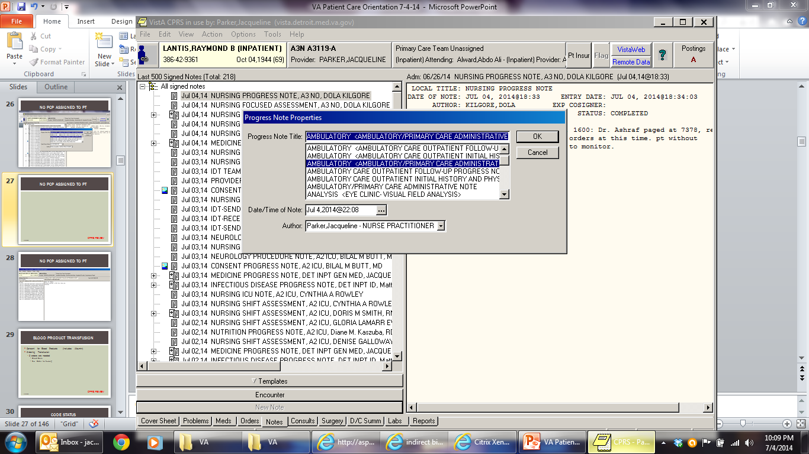
No PCP assigned to Pt
CPRS REVIEW

Slide 20
Blood product transfusion
Consent for Blood Products
Ordering Transfusion
Go to blood bank menu under “Write orders”
2 orders are needed
Blood Bank
Text Order for Nursing
CPRS REVIEW

Slide 21
Life sustaining treatment note
DNR/ DNI can no longer be ordered via text.
new policy starting June 2018
Should be addressed on all patients with serious chronic illnesses; especially with multiple admissions; this is a goals of
Care discussion.
Rescission of DNR / DNI: Complete same note indicting change of status; d/c order on chart
Select new note can text in Life and above title appears. Must fill out every field. There are 8! But if you are prepared not difficult
Orders will auto-populate once you finish ; i.e.
DNR/DNI/ full code
If no surrogate or decision making capacity you must complete consult : Ethics-Life Sustaining treatment plan
CPRS REVIEW

Slide 22
Example of template for life sustaining TX. Note.
CPRS REVIEW

Slide 23
Hospice on acute care admits
Any patient that is hospice status before admission should be admitted under option “Hospice on acute care.”
No longer use this for patients who are not officially hospice.
If a patient becomes hospice status while inpatient you can change their status to hospice on acute care.
You still write orders and care for the patient, until discharge to home hospice or admitted to inpatient hospice bed.
Palliative Care service; also may write orders, when pt. on inpatient medicine; but Medicine still is primary.

Slide 24
Deleting a CPRS Note
Highlight note to be deleted
TOOLS > FEEDBACK > “head” icon
Type instructions to delete note saved in error
Currently you have to write patient’s name and social
Security number in the box as clicking on head icon
not working.
COPY/ PASTE demographic information about the note (Pt name, date, time of note, Note title, Note Author).
SEND FEEDBACK
This creates an EMAIL in VISTA to Clinical Informatics to have note deleted
Attach an addendum to note asking readers to disregard note
If needs to be deleted immediately; call Debra Friend (during working hours weekdays; 64559 there is also a help number
on the feedback instructions.
CPRS REVIEW

Slide 25
Discharge planning: gec Referrals
Referral process used to request services such as
Home Care
Home IV Infusion
Home Based Primary Care
Subacute Rehab
Skilled Nursing
Nursing Home Placement
Hospice
Respite Care
Care coordinators should be a big help with these
THERE IS A JOB INSTRUCITON SHEET THAT CAN HELP WITH THIS. CARE COORDINATORS HAVE THEM

Slide 26
Discharge planning: gec Referrals
HBPC (Home Based Primary Care) Referrals
Community Skilled Home Care
Medication Management,
Vital Sign Management,
Disease Management
Wound Care
Rehabilitation Services
Home Safety Evaluation
Physical Therapy
Occupational Therapy
Home Infusion Services
MUST HAVE MEDICARE FOR THIS REFERRAL
CPRS REVIEW

Slide 27
GEC HBPC Note example

Slide 28
Community CARE Gec consults
May be for skilled or non skilled (home health aide)
will soon be added to your immediate admission menu along
with the HBPC consult for skilled care as above
This is similar to but not exactly the same as the HBPC, this can be placed for all patients that do not have Medicare
When in doubt place this one. HOME HEALTH CARE AIDE is always placed under Community care consults
You have to pick the number of visits needed otherwise cannot be processed, example 2 x a week for two months would be 16 visits. You have to pick the right authorization period (2 months, 3 month) the home health aide will be different, but will give you the formula.
Specify primary care on the consult, and specific services you want done. (there soon will be a check box as above on both).

Slide 29
Discharge planning: gec Referrals
GEC Inpatient Consult Referral Programs
For inpatient short stay
Inpatient Respite
Inpatient Hospice
Long Term Continuing Care
Acute Rehab
Short-Stayed Skilled
IV Antibiotics
Complex Wound Care
Radiation Treatment
Slow Rehab
Other
CPRS REVIEW

Slide 30
HOME TELEHEALTH
Consider Telehealth for following diagnoses:
CHF
HTN
DM
COPD
Palliative Care
Anticoagulation
Dementia
SCI
Obesity
FU barriers: remote areas; transportation, immobility, compliance
Consult > New Consult > Care Coordination Home Telehealth Screening

Slide 31
Community Care consults
Process used to obtain services not provided by the VA
Formerly non-VA care consults.
GEC Response may ask you to place Community Care consult to obtain needed services for pt who is not service-connected or without insurance
Examples:
Community Care GEC for Home Care; nurses, home health aids
or PT.pt does not have Medicare
Community Care for PET scan
Community Care for Non VA Facility Transfer
Community Care for Gastroenterology (pt needs Esophageal Manometry)
CPRS REVIEW

Slide 32
Community Care consults
CPRS REVIEW

Slide 33
Consents/Imed consents
Consents are done electronically
Need bedside computer
Signature pad
Consent software accessed via CPRS
Types
Procedure
Blood Transfusion
Consent for transfer to outside facility
Telephonic Consent (needs to be witnessed)
Hardware / Software problem resolution
Option to save is not highlighted → Print document
Bedside computers not working → Paper consent
Have Unit secretary scan paper consent into CPRS
Alert Nursing that a paper consent was obtained
CPRS REVIEW

Slide 34
Phone Consents
All consents (but one) have option to make consent a phone consent; please click box for this; and template will guide you with appropriate witnesses;
The administrative consent for ambulance transfer does not have an option for phone consent; This consent needs to be done if patient is being transferred to other hospital; nursing home; or by ambulance anywhere; We are trying to get this fixed; but meantime; easy fix
Choose option; patient unable to sign;
In the signature box for patient and surrogate write “Phone Consent” you sign as normal; and have witness sign;
Type name and relation of surrogate in one witness box

Slide 35
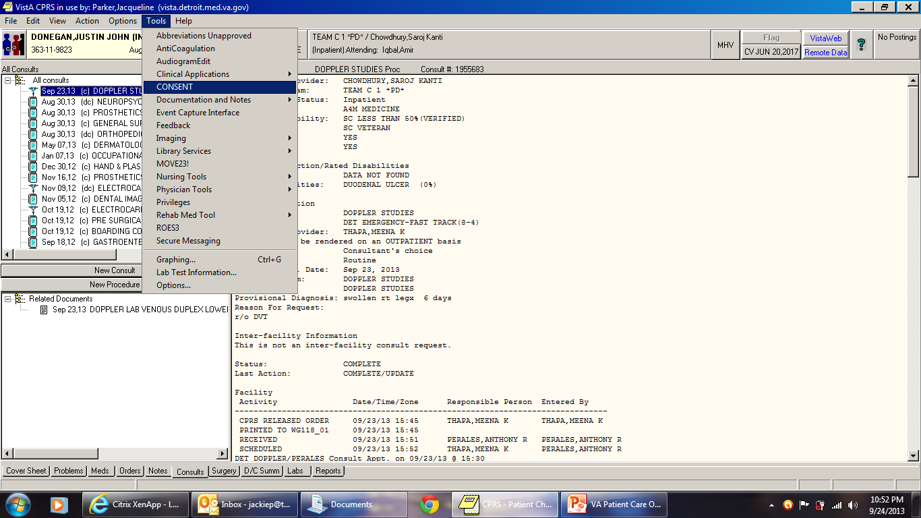
Consents/Imed consents
CPRS REVIEW

Slide 36
Diet ordering/ Nutrition /Dietetics
Regular or special diets
Tube Feeding
Supplements
TPN/ PPN (consult under medicine menu)
Dysphagia Diets
Fluid Restrictions

Slide 37
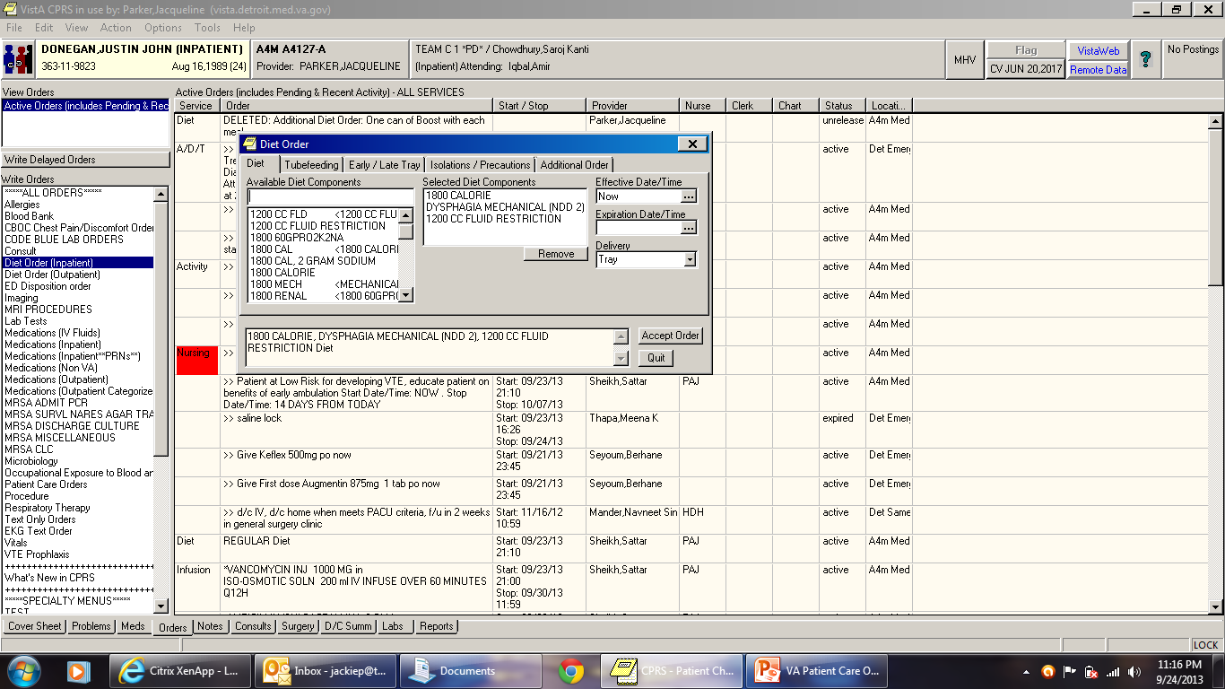
Diet ordering/ Nutrition /Dietetics

Slide 38
Pharmacy services
Pharmacy Dosing Consult; always for vancomycin; they will follow and dose; all other meds including heparin drips; they will write a note; give a nomogram; but will not dose.
Pharmacy Anticoagulation Clinic (outpatient)
Pharmacy Nonformulary Requests
Help with discharge medications or questions
we now have a pharmacist who will bring meds to bedside for your pt.
Mon-fri 9am-630pm
cisco phone 61478; may leave message with requested information
CPRS REVIEW

Slide 39
Pharmacy special Medication requests
Prior to ordering following medications, a Pharmacy Special Medication Request NOTE must be completed
CPRS-> notes-> type in special and choice pharmacy special medication request.
After signing note, box to order medication pops up allowing you to prescribe the special medication
Amiodarone
Clonidine Patch
Colchicine
Darbepoetin
Erythropoietin
Fentanyl Patch
Fluoroquinolones
Atypical Antipsychotics
Sacubitril/valsartan
Daw Cellcept (macophenolate.

Slide 40
Pharmacy special Medication requests

Slide 41
Physician order sets
Needle Stick Injury
TPN/ PPN
CIWA Protocol
Pneumonia
VTE Proph
Colonoscopy Prep (new) (under reg. inpt. Med menu.)
Paracentesis
Thoracentesis
Lumbar Puncture
Aspart Sliding Scale
Colonoscopy prep
Discharge Menu
ICU order set for drips; i.e. Cardizem, Lasix etc.
CPRS REVIEW

Slide 42
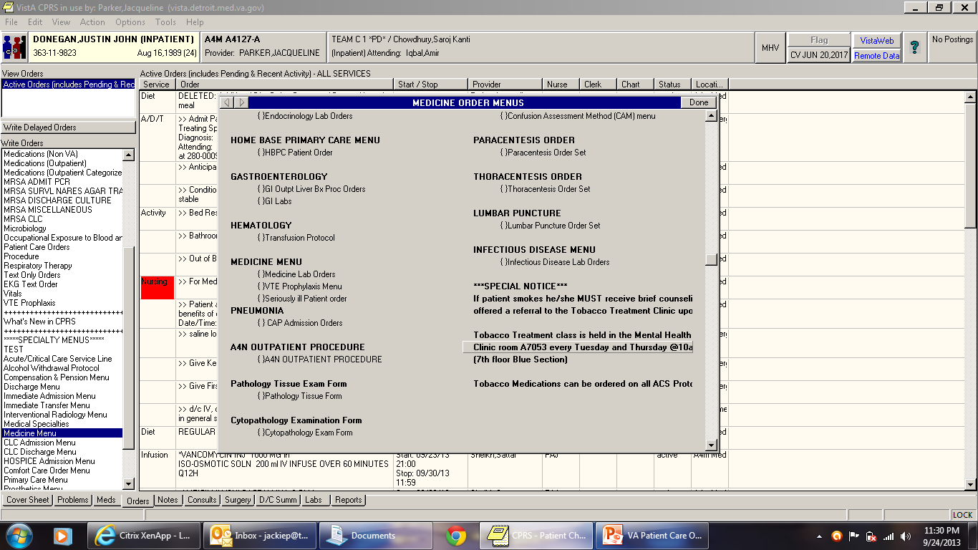
Physician order sets
CPRS REVIEW

Slide 43
Alcohol withdrawal protocol
Order set under specialty menu;
Start with this for alcoholics in danger of withdrawal
- Recommendations for labs and meds; if no s/s of withdrawal
or ciwa <7 just monitoring q 6h for 72hour
if Ciwa >7 consider transferring to stepdown ; consider telemetry for any at at high risk for withdrawal
May use CIWA med orders if needs Ativan; prn on medicine menu. Do not place all Ativan orders; on the set; determine what pt. needs and choose. Likely not ATC orders.
Again; you do not have to do everything on order set but consider them as recommendations.

Slide 44
Auto/DC orders
Medication and Text orders MAY AUTO-DC while pt is in OR: this does not always happen now and occasionally the surgery service will write your orders; but check after surgery!
Orders can also disappear after transfer or conversion to full admit. Again check.
AUTO-DC’ed orders can be viewed and selected to be reordered as active orders post-operatively
You can also copy and paste to new order.
CPRS REVIEW

Slide 45
Restraints – Medical surgical
NEW Note: “Restraint or Seclusion Orders”
Complete the template
Completion of the template generates a window for text orders for type of restraints needed
Orders are time-limited to 24 hrs
Conduct in-person re-evaluation at least once each calendar day
Orders are issued no less often than once each calendar day
CPRS REVIEW

Slide 46
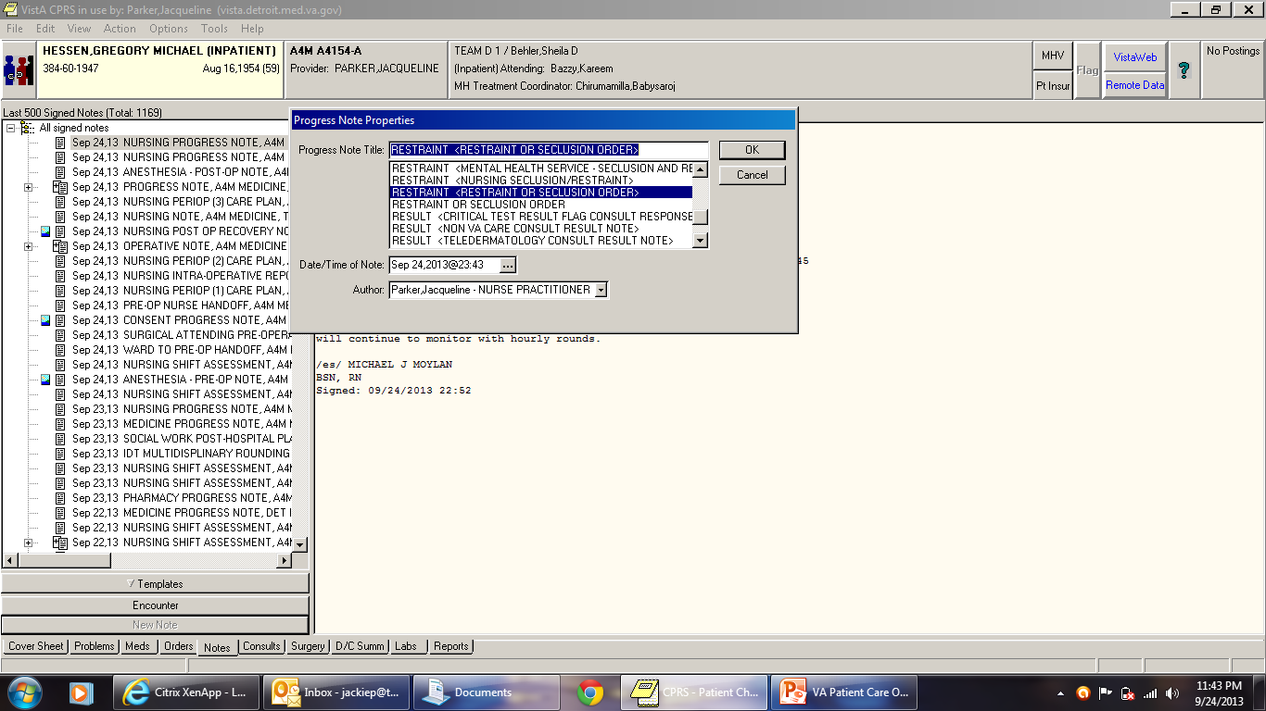
Restraints – Medical surgical
CPRS REVIEW

Slide 47
ISOLATION PRECAUTIONS
Contact precautions for + MRSA swab is automatic
You may not d/c isolation precautions; patients have to be cleared by infection control nurses; you must contact them first and wait for a note; Virginia Nelson RN; 64736; pager
250-0084; Jennifer Johnson 62227 ; 250-0849
On weekends you may d/c droplet on flu; if neg swab. Anything else you should consult ID if you want to d/c any precautions; including c-diff; TB;
Questions? call the above infectious disease nurses.
Please assess on admission if patient needs these precautions; droplet precautions for flu, c-diff for diarrhea (if appropriate. ) negative pressure for TB; etc..

Slide 48
Tests or procedure ordering
Many tests are not intuitive when ordering in CPRS
IP Resource Guide gives ordering guidelines on common tests ordered
IR, Ultrasound, general radiology, nuclear medicine, Ct scan MRI are all under the Imaging tab on your orders menu
Dopplers and ABI Carotid dopplers are now consults
must place a new consult for each procedure
PFTS are under procedures/ but are proceeded by the letter CP PFT . ;

Slide 49
resources
Nurse Practitioners
Megan Irwin NP
Michelle Wagner-Smith
Levone McCullough
Attending Physicians
Processes Guide – Paper and PDF version
Phone List
On Call Schedules (Access via VA Intranet/ Home page)
clinical call schedule; you can fine MOD, mental health
consult etc. there; along with neurology etc.
Medical Service Subspecialty list
Surgical on call list; available each day in recovery room

Slide 50
ordering
For send out labs; please draw before 2pm on weekdays
and call send-out lab number; for questions
For Tylenol levels or other drug levels in possible OD
always order STAT and call send-out
For titrated dosing i.e.. Prednisone or Librium; use complex order tab option when ordering
Some orders can only be entered as text; ex. Cpap orders for resp. , place pt. on telemetry; medications and diets are never entered as texted.
Echo ordering ; click on CP echo under the order menu; no longer use procedure menu; TEE and stress echo are also ordered here.

Slide 51
Inpatient Social Work
Rita Olugbile 61135-1332 surgery and helps with medicine
Mathew Brown Medicine; 61135-1919 ext. 61919
Michelle Crosley Medicine 61135-1926 ext. 61926
Chad Bischop Medicine PT 611353203 ext 63203
Weekend Coverage: Weekend pager 61135-9667
IP Specialty areas
DIALYSIS: Janill Deu 61135-3286
SCI: Ann Brady 61135-3684
HIV - Onelia Zurbruegg 61135-3498
Darius – Secretary 64946

Slide 52
Paging system
VA System for VA Employees
Access number: 61135-XXXX
Input 6 digit VA Pager number XXXX
Other VA Pagers
Begin with 250 or 280
No access number needed – just dial pager #
DMC Pagers
Access number: 313-745-0203
4 digit numbers
Looking up pager numbers
VISTA (from desktop)
DUZ
Operator

Slide 53
Batteries
Drained batteries mean unanswered pages – delaying pt care
Obtain batteries for your pagers from
SWITCHBOARD OFFICE in BASEMENT
Room LL 216 / Red zone (across from IRM)
Available after hours and during regular business hours

Slide 54
What number d0 you call?
Medical Emergency 6333
Code blue, Code Gray, Code white
Code Green and Code Silver
Fire 63555: Code Red
a locate the fire pull alarms
Police 63375
These extension numbers located on each telephone handset in the medical center

Slide 55
Important software
CLINICAL ACCESS
Software to access Telemetry Monitoring history and alarms
Look for DESKTOP ICON: “Clinical Access”
No password required, but you must be given access at the beginning of VA rotation; if not check with chief resident.
ESSENTRIS
Software to access STEPDOWN and ICU vital signs and I&Os
Look for DESKTOP ICON: “ESSENTRIS”
Logon access is same as your CPRS logon

Slide 56
Telemetry
View Telemetry history and alarms via CLINICAL ACCESS
Location:
Beds on A3N
C-4 telemetry ; ICU as overflow, stepdown
You can review your own telemetry on clinical access;
If you don’t know how to review in depth; refer to job instruction sheet

Slide 57
Telemetry PROVIDER Responsibilities
Make determination:
When a pt. needs continuous telemetry monitoring
When telemetry should be discontinued
Evaluate ongoing need for telemetry on a daily basis
Obtain 12-lead EKG initially for all pts and with any significant events/ rhythm changes
Initiate telemetry monitoring via written text orders
Review and sign:
24-hour Telemetry Daily Summary Report (created by MIT at 2300)
Any Arrhythmia/Urgent notification notes
Review telemetry strips from Clinical Access that have been uploaded into Vista Images for CPRS viewing

Slide 58
Incident REPORTING: JPSR
Report any Incidents or Near- Misses
Most incidents are PROCESS ISSUES that can and should be improved
Organization cannot improve unless they know what their issues are!
PLEASE REPORT! Incident reporting does not take a lot of time.
VA Intranet > Scroll down to “Helpful Links > Click on “Joint pt. patient safety reporting (JPSR) > under featured links; click and follow directions ;
There is a detailed instruction sheet.

Slide 59
Ordering equipment or supplies
Outpatient Pharmacy → Medications (Outpatient)
Dressing supplies
Urinary Catheters
Ostomy supplies
Suction catheters
PleurX catheter supplies
Nutrition supplements (Place Dietician Consult for approval)
CPRS REVIEW

Slide 60
Ordering equipment or supplies
Prosthetics Consult
IV Poles
Suction Machines
Nebulizer
Blood Pressure Monitors
Hospital Beds
Hoyer Lifts
Bed Trapeze
Compression Stockings
Weight Scales
Diabetic shoes
Diabetic Socks
(In comments: ask for supplies to be delivered to floor)
CPRS REVIEW

Slide 61
Ordering equipment or supplies
Physical Therapy Consult
Walkers
Manual Wheelchairs
Canes
Rollators
Crutches
TENS unit
Occupational Therapy Consult
Shower bench
Raised toilet seats
Reachers
Sock Aids
Wrist splints
Grab Bars
Shoe Horns
CPRS REVIEW

Slide 62
48-Hour Observation
Medication Reconciliation
FU appts
Discharge Note
Discharge Order (Use Discharge Menu)
Does not need Discharge Summary
NOTE: If pt. requires hospitalization longer than 48 hrs.:
Pt must be discharged from Observation and readmitted to inpatient status

Slide 63
DC to VA Detroit CLC (Nsg Home)
Will be notified by CLC Providers when bed is available
If requesting new admission to clc will need GEC referral
Medication Reconciliation
FU appts
Discharge Note
Discharge Order (Use Discharge Menu)
Discharge Summary
Delayed Admission Orders: Transfer from ASIH to Community Living Center – will be completed by CLC providers

Slide 64
Interfacility transfer to Non-Va facility
Contact Chief of Staff (Dr Gruber) for permission
Accepting physician handoff
Bed availability – Contact Admitting dept. of receiving hosp
Community Care Consult to NON-VA Facility
Arrange for Ambulance Transportation
**CONSENT for INTERFACILITY TRANSFER
**INTERFACILITY TRANSFER NOTE
Medication Reconciliation
FU appts
Discharge Note
Discharge Order (Use Discharge Menu)
Discharge Summary

Slide 65
Discharge AMA
Counsel patient on risks
Have pt sign AMA paperwork
AMA Note
Medication Reconciliation
FU appts
Discharge Note
Discharge Order (Use Discharge Menu > AMA)
Discharge Summary

Slide 66
Death
Pronounce pt
Notify Family
Autopsy request
Medical Examiner Case?
Progress note documenting above
FORMS: Pt Demise Checklist/Authorization for Autopsy
Gift for life
Discharge Note
Discharge Summary
Death Certificate signed within 24 hrs (attending)

Slide 67
Transfer to another floor
**For transfer to higher level of care: Call Precertification Nurse
**Call Bed Control for bed assignment/ availability
Consult MICU if ICU care needed
If transfer to another service, contact service provider for acceptance
**Provider providing care on receiving floor writes DELAYED TRANSFER ORDERS (Can only be done when bed available)
Note; when we accept pt. from ICU/ we write orders..
**Sending provider completes IDT SENDING PROVIDER NOTE
**If there is a provider change, the accepting provider completes IDT RECEIVING PROVIDER NOTE
Medication Reconciliation
(** = must be completed for Nursing to transfer pt)

Slide 68
Transfer to B2/ Psychiatry
Contact Inpatient Psychiatry providers for acceptance and handoff
Call Bed Control for bed assignment/ availability
Precertification
IDT Sending Provider Note
Medication Reconciliation
FU appts
( No Discharge Note )
MRSA swab and vaccinations (use Discharge Menu)
Delayed Transfer Orders completed by Inpatient Psychiatry Providers

Slide 69
Conditions that must be transferred to outside facility
Major Trauma
Neurosurgery Emergencies
STEMI
Obstetric Emergencies
Gynecologic Emergencies (if GYN provider not available)
Symptomatic thoracic or abdominal aneurysms
Functioning Solid-Organ Transplant (kidney, liver, pancreas, heart, lung, small bowel or multivisceral) on maintenance immunosuppression requiring hospitalization
If any question; or ER is not screening pt. properly
CALL YOUR ATTENDING

Slide 70
Expiring medications
Daily review the inpatient medications
Narcotics automatically expire after 72 hrs
Antibiotics expire after 7 days
IV Orders look at order and it will expire in 7 days if not specified

Slide 71
Home o2 evaluation
Consult Respiratory therapy detail you want home O2 eval.”
Respiratory therapy consult: Not home O2 consult this is a recent change
Document why; if possible document hypoxia in request.
Call home O2; desk: 63483 Tanya; 65900 Home O2 Prescriptions need to be signed by MD (RT will send Prescription via CPRS for electronic signature)
Pt/family need to call Home O2 “800” number to arrange for home delivery of oxygen at discharge (RT gives this number to pt/family)
Planning weekend discharges, have this done prior to weekend; but now can be delivered on Saturday

Slide 72
Mental health resources
Mental Health Clinic
Inpatient Mental Health (B2)
Mental Health Intensive Case Management
Partial Hospitalization Program
Chemical Dependency Program
Intake Exam
7th floor
M W F btw 8am and 10am
PTSD Clinic
Military Sexual Trauma (MST) Service
Services for Homeless Veterans

Slide 73
When in doubt, just ask.

